Slide 1
A Doll’s House
By Henrik Ibsen

Slide 2
Henrik Ibsen wrote A Doll’s House in Norway in 1879, and the play presumably took place sometime in the same decade.
Set in an upper-middle class home, the play demonstrates the importance of social class in late-19th century Norway.
Born into the upper-middle class himself, Ibsen not only understood the importance of social class, but also the expectations placed on its members.
Likewise, A Doll’s House tells the story of Nora and Torvald: a married couple living in a society where to keep your social standing, you have to abide by its strict, and at times, suffocating standards.
Nora and Torvald are living proof that upper-middle class life can be a comfortable one–if you fit into its narrow margins.

Slide 3
Class in 19th c. Norway
The growth and prosperity of Norway’s upper-middle class began in 1843, with a great economic boom. As a result, the upper-middle class became larger. Before this class existed, most of the people with wealth were a part of the aristocracy, and therefore born into money. Now, people could work their way up, and enter into the upper-middle class through hard work and education. While this economic boom brought prosperity, it also brought an obsession with, and an over-awareness of money.
Commonly referred to as “bourgeois respectability,” expectations of the upper middle-class included financial success without any debt, good morals (or at least making it appear that’s the case), and a stable, patriarchal family.

Slide 4
Women in 19th c. Norway
A woman’s main responsibility centered around being a housewife, whose most prominent task was to serve her husband and children.
Ibsen wrote in his notes for A Doll’s House in 1878, “A woman cannot be herself in contemporary society, it is an exclusively male society with laws drafted by men, and with counsel and judges who judge feminine conduct from the male point of view.”

Slide 5
View the Opening Scene
Act I—Opening Scene
Discussion:
Describe Torvald.
Describe Nora.
What do you notice about their relationship?
Make predictions about the plot of A Doll’s House.

Slide 6
A Doll’s House
Project Due
________________________________

Slide 7
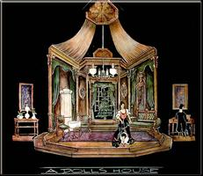
Read A Doll’s House Act One
In your textbook pp. 942-971.
Answer p. 971 #4, 5, & 7.
Use quotes and lead-ins.
Due ______________________

Slide 8
Read A Doll’s House Act Two
In your textbook pp. 975-997.
Answer p. 997 #6.
Use quotes and lead-ins.
Due ______________________

Slide 9
Read A Doll’s House Act Three
In your textbook pp. 1001-1022.
Answer p. 1022 #5 and p. 1023 #2 & 3.
Use quotes and lead-ins.
Due ______________________

Slide 10
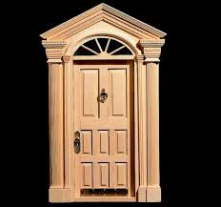
View the Ending Scene
Act 3—Ending Scene
Discussion:
What do you think of Nora’s decision?
How do you feel about Torvald?

