Slide 1
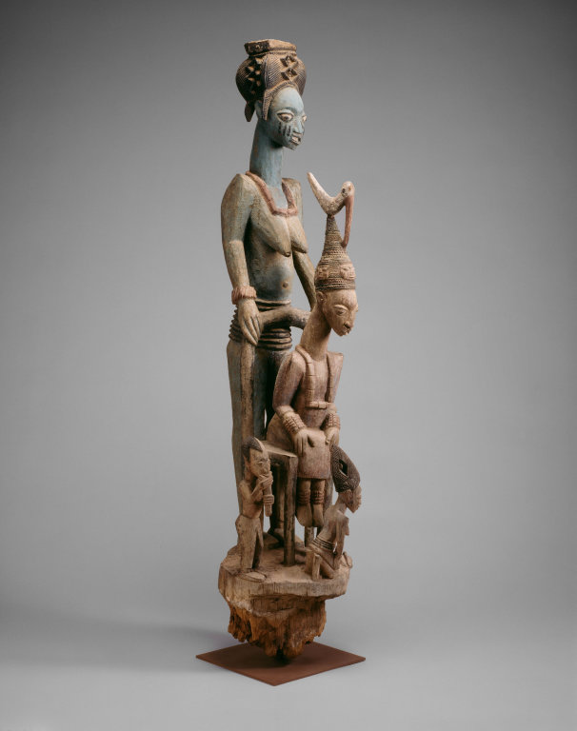
Faced visitors in the inner palace courtyard of the king of Ikere.
Veranda Post of Enthroned King and Senior Wife (Opo Ogoga) Olowe of Ise (Yoruba peoples)
c.1910-1914 C.E.
Image from The Art Institute of Chicago

