Slide 1
Candide
Optimism

Slide 2
Historical context
A terrible earthquake struck Lisbon, Portugal in 1755, claiming nearly 25,000 lives.
Seven Years War 1756-1763
Prussia, Britain, Hanover vs. Austria, France, Russia
Prussia kept most of its land because of Fredrick the Great
The search for El Dorado
Mythological land of gold in South America
Francisco Vasquez de Coronado and Sir Walter Raleigh

Slide 3
Historical context
French Rule (1715-1774)
Middle class upset with their rulers
Nobles and high ranking church members enjoyed special privileges
King had the power to arrest anyone for any reason
Unequal taxation
Spanish Inquisition
Supported the Catholic Church
Persecuted Protestants, Jews, Muslims, etc.
Auto da fe: Ceremonies where people were tortured until they joined the Catholic Church; Tortured to death if beliefs were not renounced

Slide 4
Philosophical context
Natural Law—human reason can understand physical nature and human nature
Natural Rights—life, liberty, property
John Locke-- Governments exist by the consent of the people in order to protect the rights of the people and promote the public good; Governments that fail to do so can be resisted and replaced with new governments

Slide 5
Philosophical context
Sir Thomas More
Wrote Utopia which portrays a nation based on rational thought, with communal property, great productivity, no rapacious love of gold, no real class distinctions, no poverty, little crime or immoral behavior, religious tolerance, and little inclination to war.
Utopia translates to “No Place”

Slide 6
Philosophical context
Gottfried Leibniz
German mathematician and philosopher during the enlightenment period
Wrote “La Monadologie” in 1714
Our world is the best of all possible worlds.
Nothing happens without a reason; there is no effect without a cause
God is infinitely good.
God is omnipotent, yet limited.
He can only cause possibilities to exist if there are no contradictions to refute it.

Slide 7
satire
Writing that uses humor to ridicule human foolishness in an effort to inspire change.
Uses mockery to…
Demonstrate people’s flaws (such as hypocrisy or failures)
Evoke change by creating awareness or adjusting thoughts/actions

Slide 8
How is this a satire?
What human fault is explored?
What techniques are used to expose those faults?
What does the director hope to achieve?

Slide 9
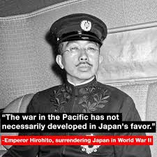
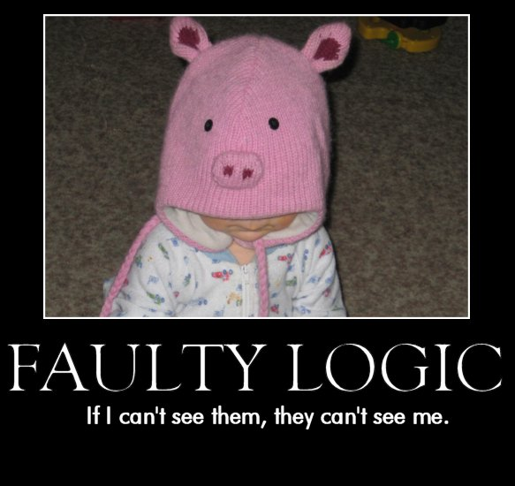
Satire Techniques used in candide
Exaggeration or Hyperbole
Understatement
Faulty Logic

Slide 10
In your textbook…
Read Great Minds Do Not Think Alike pp. 798-799.
Read Voltaire bio p. 800.
Read Satire information p. 801.

Slide 11
Begin Candide Analysis
Read chapters 1&2 of Candide pp. 802-806.
What theme is explored in these chapters? Provide a quote from the text and explain how it supports the theme.
What satirical techniques are used? Provide a quote, name the satirical device, and explain the social injustice Voltaire wishes to expose.
What historical event is paralleled? Provide a quote and explain the real world event that prompted the fictional event.

