Slide 1
Chapter 33
By: Alan, Ewan, Kayleigh, Rose, Ashlynn, Antarius and Jennifer

Slide 2
Introduction
Many leaders and activists post-colonization faced great challenges:
-Internal rivalries
-Civil war (in some cases)
Both conflicts were between social and ethnic groups
National leaders tried to win support of peasants and working-class townspeople by promising them
-Jobs
-Civil rights
-Equality
Once independence was won from the Europeans, these promises would be full-filled.
This was not possible in almost all post-independence realities.
(Political)

Slide 3
Introduction
Economic growth was hampered by unprecedented rates of population increase, structure of international market, and the underdeveloped state of most colonial economies at the time of independence.
-Goods and services were unequally distributed, leaving some rich and a great majority poor
-Not enough resources to take care of everyone, even if they were distributed equally
When the promises of a better society failed to materialize, personal rivalries and long-standing divisions resurfaced.
(Economic)

Slide 4
Introduction
Produced political instability:
-Recurring problems of famine and starvation in parts of Africa
-Rivalries and civil wars consumed resources that could’ve been used to develop economy
Politicians were too focused on keeping nations together, and ignored soaring population increase, the uncontrolled urban growth, rural landlessness, and the environmental deterioration.
All of this is what lead to the political instability in the young nations in Africa, Asia, and the Middle East.
(Political)

Slide 5
Indira Gandhi
Prime Minister of India, dominated Indian politics from 1966-1984.
She lived in a nation and world threatened by nuclear confrontation because of the Cold War between the United States and the Soviet Union. Gandhi stood up for the poor and defenceless, and fought for ways to feed the people and then to improve the standards of one of the poorest and most populous nations in the world.
Assassinated by Sikh radicals
(Political)

Slide 6
Population Struggles
POLITICAL
Leaders of the post-colonial nations promoted mass industrialization to try and catch up to the Western nations.
Their efforts were diminished by the high rate of population increase in the nations.
Colonial rule played many key roles in causing the rate of population growth to increase.
Decreasing rates of war and famine (mainly India and Java) caused population to increase even though the birth rate remained stable.
Medical advancements and increased hygiene led to population increase in the early 20th century. Efforts to destroy major diseases such as smallpox were created.
Asia’s population started large and has begun to level off in recent years.

Slide 7
Population Struggles
High birth and smaller death rates are causing Africa’s population to grow rapidly.
Since the 1980s, the AIDS epidemic has caused the rate of population growth to decrease.(I)
Africa’s poor economy can barely support moderate population growth, causing the potential population growth to decrease further. (E)
400 Million people live on Africa’s tiny economy
The European policy of limiting industrialization in their colonies caused the newly independent nations to not have the ability to employ more workers. (E)

Slide 8
Population Struggles
CULTURAL
Many African and Asian cultures met birth control efforts with resistance due to religious and social beliefs.
The traditional Hindu belief that the eldest son must perform a ceremony at his father’s funeral pyre is an example of this.
In Africa, children (especially sons) are critical to the family because children usually take care of their parents when they can no longer work.
Men often performed the burial rites and rituals of their parents.
Women’s main roles were in agriculture and commerce, causing a value for girls in African society.
In Asia, women had high dowries and little to no choice of occupation.
The rate of infant mortality was high before the 20th century and it was common to lose 10-12 children.
Up to 40% of the developing countries populations are dependant on others to live

Slide 9
The Parasitic Cities
After rural areas were becoming overcrowded, many people moved to the cities to try and find a better life.(E)
Due to the lack of rapidly expanding industrial sectors, the cities did not have anything to offer most of the people who came there.(E)
The lack of opportunities caused large slums and shanty towns to appear around cities.(E)
The poor are often bribed to be used as mobs or shock troops in ethnic and political clashes (P)
Governments had to appease them by keeping necessity prices low.(E)
The cities cannot support themselves and many resources have to be brought in from other places.(E)
Rural overpopulation depleted the soil and has caused fast rates of deforestation. (I)
Pollution is hurting the people and the environment in many societies as well. (I)

Slide 10
Women’s Rights (Social)
Women won the right to vote in early and mid 20th century which caused more nations to advocate for women’s suffrage
Women's activism produced some equality in legal rights, education, and occupational opportunities under the laws of new nations
Limited gains were available for women
Market slumps threw countries deeply into debt, bringing out the
Indian tradition: women serve husbands and sons first then eat leftovers
Asian, Middle Eastern, African, and Indian were less educated and healthy than men at comparable social levels

Slide 11
Neocolonialism (Economic)
Newly independent countries were dependent on cocoa, palm oil, coffee, jute, and hemp and minerals included copper, bauxite, and oil (economists called these minerals primary products)
Nationalist leaders aimed at aimed at building an industrial base that would, support the rapidly increasing populations
Many nations from colonialism had small chance of becoming industrial
Revenues saved from peasantry but was little once bureaucrats were paid, public works and other educational needs
Emerging nations relied on sale of crops and minerals to earn the money
Price fluctuations created nightmares for planners in developing nations

Slide 12
Important Women
Indira Gandhi-daughter of Jawaharlal Nehru (India’s first prime minister)
Corazon Aquino- president of the Philippines in the post-Marcos era of the late 1980s (husband was the martyred leader of the Filipino opposition to Ferdinand Marcos)
Benazir Bhutto-prime minister of Pakistan (daughter of a domineering Pakistani prime minister)
Even the most powerful women only won support because they were connected to powerful men.

Slide 13
Africa

Slide 14
Economic Factors
The new nations needed investment funds and essential technology, so they turned to international organizations or rival industrialised nations for assistance.
While helpful, other nations often had many select terms and conditions for borrowing funds: requirements for trade commitments, favoring investors from the lending nation, forced alliances, permitting military bases on the borrowing nation’s territory, the lending nation regulating how money is invested and repaid, as well the borrowing nation having to alter their economy.

Slide 15
Political Factors
Military leaders rose to power across the new nations because of their greater ability to overthrow the existing governments.
Most of the military leaders were anti communist and gained support from Western governments.
Common traits of this military rule include, authoritarian regimes, removal of civil liberties, attempts to reduce social unfairness and improve living standards, notorious for corruption, political rivals were often jailed or killed, directing large amounts of resources to benefit only the military, and bans on civilian political parties.

Slide 16
Important Political Figures in Africa
Kwame Nkrumah - led Ghana’s independence movement, first Prime Minister of Ghana in 1957, wanted social reforms and economic uplifts, rival political parties tried to block his plans, supported by USSR, faced hostility from Western countries and investors, cocoa prices dropped in global market and caused resources for reforms to be inadequate so they failed since he refused to cut back on his reforms, 1960s banned rival parties and jailed other political leaders, 1966 left on peace trip to Vietnam and was overthrown
Gamal Abdul Nasser - took control in Egypt after Free Officers movement seized power in 1952, revolution overthrew the corrupt khedival regime
Hasan al-Banna - founded Muslim Brotherhood in 1928, focus on social uplifts and reforms, started strikes and riots in Egypt in 1930s, died in 1949 but members continued to spread organization’s influence among middle and lower classes

Slide 17
Military Responses: Dictatorships and Revolutions

Slide 18
Egypt
(p) Egypt won independence from Britain in the 1930s, leaving the British with only the Suez Canal. When khedive Farouk took over with his wealthy elites in power, the lives of everyday Egyptians did not improve much (s).
(p) The Free Officers Movement began with the Revolutionary Command Council and the Muslim Brotherhood, both groups who were preparing to end the khedival regime and take power.
(p) Hasan al-Banna, a teacher and independence supporter, began the Muslim Brotherhood in 1928. They began with doing services such as building clinics, promoting land reform, and educating women and lower class citizens (s). They held riots against the khedive, which led to al-Banna being murdered by the government in 1949.
(p) Gamal Abdul Nasser and the Free Officers found their chance to revolt in 1952 when Egyptians were angry at the government for their loss of the Arab-Israeli war and tensions with Britain over the Suez Canal. Nasser became the head of the military government they had established.

Slide 19
Egypt
(s, p, e) Reform programs led by Nasser:
Redistribute land
Give education through college paid for by the government (s)
Employed citizens in gov’t jobs (e)
Lowered prices of basic food necessities (e)
1956 got the British to leave the Suez Canal (p)
Restricted foreign investments (p, e)
Although these seemed to be good reforms , most of them didn’t work:
Landlords found ways to keep their land from being redistributed (s)
Population boom- couldn’t afford everything, didn’t have enough land for everyone (i)
Aswan Dam Project- built dam on Nile, but caused increase of parasites in the river and decrease in land fertility below the dam (i)
Didn’t have money and resources to take on all projects successfully (e)
Lost Six- Day War (p) with Israel in 1967, which cost even more money
Nasser was succeeded by Anwar Sadat, then later Hosni Mubarak, who had to cancel the reforms and later opened up financial aid and investments with Europe and US. (p)

Slide 20
India
After freedom from Britain, Jawaharlal Nehru, the first prime minister of India, wanted social reform, development of the economy, and to preserve civil rights (s, p, e)
Was similar to Egypt because it shared Nasserite socialism and state intervention (p, e)
But was more successful because they preserved civilian rule, dealt with overpopulation by building a larger science and industry system, and built up a more skilled middle class
Pushed state intervention and foreign investments (p, e)
Invested in the Green Revolution, helping to create higher crop yields for their large population (i)
Developed high tech sectors and is still one of the leading technology areas in the world (i)
All these developments have helped many people, but really about 50% of the population is still where it was before it became independent because of lack of resources (s)

Slide 21
Iran
Iran was only a sphere of influence to Britain and Russia and was never a colony, causing weak communications and bureaucratic structure and led to modernization being difficult for the Pahlavi shahs (p)
The 2nd shah tried to develop change through the government (p)
He neglected many parts of the Muslim culture when he initiated reforms, which led to religous leaders and citizens getting angry (c)
Ayatollah Ruholla Khomeini, a Shia Muslim who was believed to be divinely inspired, led a revolution in 1979 with a goal to become like the past golden age of Muhammed (p, c)

Slide 22
Iran
Khomeini wanted to restore the ‘true beliefs’ and establish strict religious codes:
The US and Europe were seen as ‘satanic’ (p)
Harsh punishments such as cutting off limbs and stoning (p)
Women were required to wear veils (c)
Women’s careers, which were promoted by the shahs, were restricted (s)
Saddam Hussein, leader of Iraq, took advantage of the turmoil and wanted oil
Iran-Iraq War began, and Iran suffered greatly because of Khomeini’s refusal to surrender (p)
Finally surrendered in 1988
Left Iran a mess- food and fuel shortages, reforms failed

Slide 23
South Africa

Slide 24
Post-Independence
Gained independence from Great Britain in 1960
White nationalists controlled the state, instituted apartheid to control black majority
Apartheid remained until the 1990’s
It separated all aspects of life including recreation, housing, education, work, and medical care
“Homelands” - areas where tribal groups lived; designed to end racial division
These Homelands were very small, poor, and overpopulated
Laborers emigrated from the Homelands to work in South Africa Proper, leaving their families behind

Slide 25
Police State
White minority instituted strict police state to maintain control
Protest in any form was strongly suppressed
Black organizations illegal and said leaders were imprisoned
Regime separated blacks by playing on tribal divisions
Regime also incited fear in white minority to keep the state in power
System began to fall apart due to bankruptcy, boycotts, and rising racial tensions
Nelson Mandela was freed in 1990 and was voted in as the first black president in 1994
This was the first election where black citizens were allowed to vote

Slide 26
Comparing Emerging Nations
The Middle East and Africa faced similar developmental problems as the Middle East and Africa
India is one of the only successful emerging nations, in contrast to the rest of Southwest Asia and learned from Great Britain’s method of government, while also establishing the caste system
After the fall of the Ottoman Empire and European division, the Middle East still struggles to this day to establish stable governments and peace
Africa also struggles since it has just been granted independence for the last 100 years after long colonial rule; its culture is forever changed
Given time, these budding nations will grow into successful states

Slide 27
Artwork

Slide 28
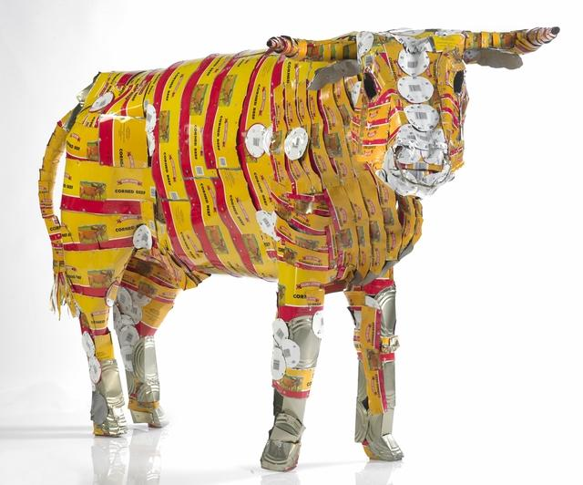
Michel Tuffery, Pisupo Lua Afe (Corned Beef 2000), 1994, mixed media, flattened cans of corned beef (Museum of New Zealand Te Papa Tongarewa Collection)
Pisupo Lua Afe is one of Tuffery’s most iconic works, made from hundreds of flattened corned beef tins, riveted together to form a series of life-sized bulls.
Despite evident connections to Pop Art, it’s impossible to read this work solely in the terms of Western art history, or categorize it as a specific western art style. Instead the meaning of this peace lies in the politics of the Islands.

Slide 29
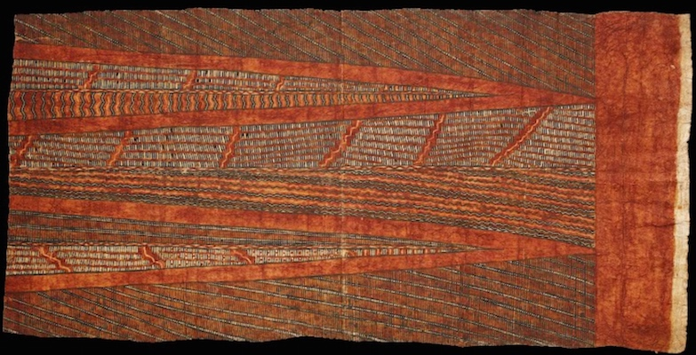
Pisupo is now a generic term used to describe the many types of canned food that are eaten in the Islands—including corned beef. It as a favorite food source in the Islands as wall as an important part of the ceremonial gift economy. At weddings and birthdays, and other important life events both in the Islands and in Islander communities in New Zealand, gifts of treasured textiles like fine mats and decorated barkcloths are made alongside food items and cash money. But unlike the Island feast foods gifted at these events—such as pigs and large quantities of root vegetables—canned corned beef is a processed food high in saturated fat, salt and cholesterol (a type of fat that clogs arteries). These are all things that contribute to disproportionately high incidences of diabetes and heart disease in Pacific Island populations as diets which where formerly composed of locally grown fruits and vegetables, seafood, coconut milk and flesh, witch now give way to cheap, imported foodstuffs.

Slide 30
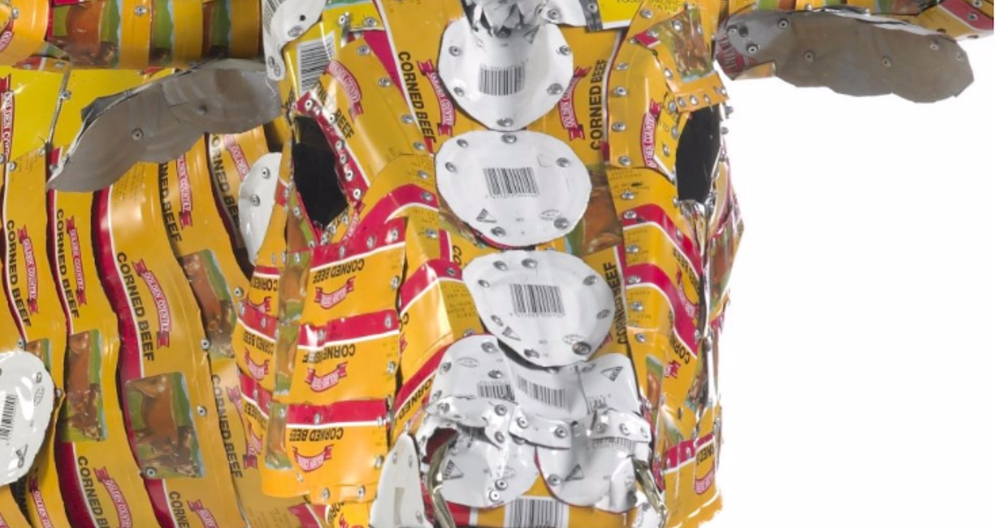
So Tuffery’s sculpture is impossible to separate from the ceremonies as well as the declining health in the islands, but Pisupo Lua Afe also critiques serious issues of ecological health and food sovereignty. Tuffery is interested in the introduction of cattle to New Zealand and the Pacific Islands and how they impact negatively on the plants, landscapes and waterways of these countries, as well as how industrialized approaches to farming disrupt traditional food production.
The softness of a real bull vs the hardness of the tin bull represent the possible negative effects of the use of corn beef on the ecosystem. All the cans disposed will take a toll on the island even as they are attempted to be discarded in a eco friendly way.

Slide 31
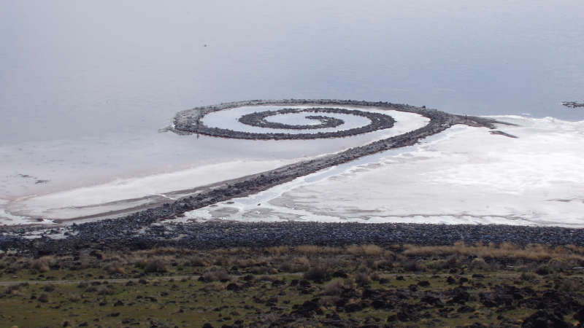
Spiral Jetty. Great Salt Lake, Utah, U.S. Robert Smithson. 1970 C.E. Earthwork: mud, precipitated salt crystals, rocks, and water coil
The sculpture is built of mud, precipitated salt crystals, and basalt rocks. It forms a 1,500-foot-long, 15-foot-wide counterclockwise coil jutting from the shore of the lake. The sculpture is sometimes visible and sometimes submerged, depending upon the water level of the Great Salt Lake.
It is considered land art, which was a recurring trend in the beginning of the 20th century, often drawing inspiration from pre-european groups that would use the earth to their advantage when creating art; as well as forms in nature. This specific piece is drawing inspiration from an old story of a whirlpool that connected the lake to the Pacific ocean.

Slide 32
The spiral once submerged in water and allowed the land and the sea to touch, but now the water has receded and sand in in between the rocks, this is a piece of art that was meant to change with the nature around it.
Robert Smithson wanted to watch the art breakdown with nature and capture the ideas earlier artists had about the overwhelming power of nature and the smallness of man.
Reflects the imperialism nature of the era where people began looking at the way imperialism was hurting the world and the ecosystem, looks at passage of time in an amazing landscape.
The art becomes part of the passage of time and the process of nature and can’t be conserved or placed in a house or museum. Plays with the idea of entropy, which is a concept in physics, that believes that eventually all things will descend into chaos. As the landscape changes so will the art, leading it to eventually break down. This greatly rivals museums that try to do the impossible and conserve art beyond time. The piece of art ultimately make us aware of the breakdown of all things and the length of time it takes the world to break down, making us consider the short and irrelevant length of our lives compared to the rest of the universe.

Slide 33
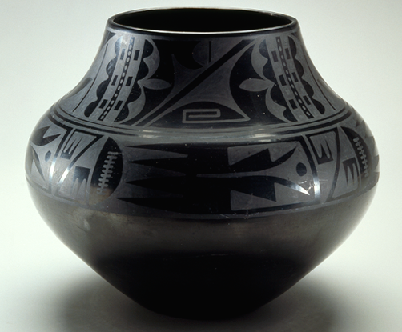
Black-on-black ceramic vessel. Maria Martinez and Julian Martinez, Tewa, Puebloan, San Ildefonso Pueblo, New Mexico, c. mid-20th century C.E. Blackware ceramic. P. 863
This is a ceramic pot made by Maria Martinez, who became one of the best-known Native potters of the twentieth century due to her excellence as a ceramist and her connections with a larger, predominantly non-Native audience.
Before the arrival of the railroad to the area in the 1880s, pots were used in the Pueblos for food storage, cooking, and ceremonies. But after the expansion of the rail line these practices were in decline due to a sudden influx of inexpensive pots. By the 1910s, Ms. Martinez found a way to continue the art by selling her pots to a non-Native audience where they were they where they began to be purchased as art rather than a household object.

Slide 34
The pots are very difficult to make: The clay is found locally. To make the pottery stronger it has to be mixed with a temper made from sherds of broken pots that had been pounded into a powder or volcanic ash. When mixed with water, the elasticity of the clay and the strength of the temper could be formed into different shapes, using only the artist’s hands as the potting wheel was not used. The dried vessel needed to be scraped, sanded, smoothed, then covered with a slip (a thin solution of clay and water). The slip was polished by rubbing a smooth stone over the surface to flatten the clay and create a shiny finish. Over the polished slip the pot was covered with designs painted with an iron-rich solution using either pulverized iron ore or a reduction of wild plants called guaco. These would be dried but required a high temperature firing to change the brittle clay to hard ceramics.
Making ceramics in the Pueblo was considered a communal activity, where different steps in the process were often shared. The potters helped each other with the difficult and tedious tasks such as mixing the paints and polishing the slip. This caused Maria Martinez to be hesitant to sign her name on the bottom of pots, until she learned that her name increased profits, in witch case she began singing on artwork that was not even her own.

Slide 35
The pot pictured here features a design that was based on pottery sherds found on an Ancestral Pueblo dig site dating to the twelfth to seventeenth centuries. The Martinezes worked at the site, Julian Martinez spent time drawing and painting the designs found on the walls and on the sherds of pottery into his notebooks, designs he later recreated on pots. In the 1910s, Maria and Julian worked together to recreate the black-on-black ware they found at the dig, experimenting with clay from different areas and using different firing techniques. Using the Santa Clara pots, they discovered that smothering the fire with powdered manure removed the oxygen while retaining the heat and resulted in a pot that was blackened. This resulted in a pot that was less hard and not entirely watertight, which worked for the new market that viewed the ceramics as art.
The olla pictured above features two design bands, one across the widest part of the pot and the other around the neck. The elements inside are abstract but suggest a bird in flight with rain clouds above, perhaps a prayer for rain that could be flown up to the sky. These designs are exaggerated due to the low rounded shapes of the pot, which are bulbous around the shoulder then narrow at the top. The shape, color, and designs fit the contemporary Art Deco movement, which was popular between the two World Wars and emphasized bold, geometric forms and colors.
Maria Martinez brought the distinctive Pueblo style into a wider context, and the modern world.

