Slide 1
Chapter 36
Globalization and Resistance
Trinity Estes, Hailey Crane, Audrey McNeal, Ainsley Cole, Joseph Womeldorf, Alex Colas

Slide 2
Social
Cheap labor and relaxed, or lack of, labor laws in countries such as Mexico brought about other countries building factories in said countries, but then distributing them in their own countries
Harsh working environments
Many of these workers were women and some children as well
Rates of child labor rise in south and southeast Asia, but are graually diminishing in other areas of the world
Gaps between the poor and those with more money widen
Growing middle class in Latin America, India, and China
Urban slums and exploited labor increases
Slowly growing populations in industrial countries, but rapidly growing populations in Latin America, Africa, and parts of Asia; some areas, including Italy, Greece and Japan, had almost no internal population growth by the 1990s-led to new labor needs, particularly at lower skill levels. These needs were met using immigration

Slide 3
Social
Strong sense of nationalism in most areas is decreasing and being replaced by more cosmopolitan interest in wider influences and contacts
Unemployment rates of 30 percent or higher common in Africa
Prostitution and the sale of body organs is popular due to increasingly desperate poverty in many societies
Expansion of middle-class consumerism due to larger middle class; causes global epidemic of obesity, especially in children
Growing refugee populations from parts of Africa, the Balkans, and the Middle East which call for UN humanitarian intervention
UN conferences began broadening their topics to gender and population control issues
Women in many African countries were able to appeal to UN proclamations on gender equality as a basis for seeking new property rights in the courts

Slide 4
Social
Increase in international nongovernmental organizations (INGOs) for human rights, labor, environmental, and other issues
Amnesty International-a London-based human rights agency; began in 1961
Internet-based petitions against torture, labor abuses, and the death penalty strive to gain policy responses
Range of criteria for INGOs steadily expanded
Rape was internationally recognized as a war crime in the 1990s

Slide 5
Political
China
Reasons for Globalization and Resistance:
China’s modern day economic “Open Door Policy” - A policy by Deng Xiaoping in December 1978 that allowed foreign businesses to set up in China. Probably gave way to capitalism
Soviet Union Glasnost
Migration and…
Nationalism and New Religious Currents. Religious revival, Russian Orthodoxy, Fundamentalism
The Global environment concerns, Greenhouse effect
Disease?
Global Balance
Globalization is not new in this period, but reached new heights
(Ai weiwei)

Slide 6
Political
Since China’s 1978 decision to enacted the policy to allow foreign government to set up on the Chinese mainland, and the Soviet Union’s “glasnost” or “openness” policy to reinforce global political and military leadership, the collapse of the Soviet Union brought much of eastern Europe and Central Asia into the process.
Globalization: Causes and Processes. The spread of globalization at the end of the 20th century came in part by political decisions. China’s move, in 1978, to open its economy to foreign trade was crucial. The increasing openness of the Soviet Union, from 1985 on, and then its collapse, brought large areas of eastern Europe and central Asia into the world market which hastened their development. *
Countries in south Asia and Latin America followed, until only a few countries held to isolation in the 1990s. The use of English as the international language facilitated the process. Because of the resources in theses struggling countries, multinational companies were able to determine policies in weaker nations. These policies that call for the dependency on cheap, outsourced labor is capitalism.
Globalization is inevitable and was in part caused by certain policies that built the modern world economy with core, peripheral, and semi-peripheral countries.
Economic Globalization: Business Organization and Investment. International investment has accelerated significantly. Exports and imports have increased and multinational corporations have extended business organization across political boundaries. They continue the search for cheap raw materials, and invest in nations with high interest rates. Because of their resources, multinational companies were able to determine policies in weaker nations. Even as they polluted the environment, multinationals promoted industrial skills and brought more-enlightened labor policies. The poor and the better off are separated by a widening gulf in industrial countries, although a middle class is growing in some nations.
Migration. During the 1990s, international migration patterns continued. Countries with negative population growth needed new lower-skilled workers. Their arrival resulted in tensions between local populations and the new arrivals. One new phenomenon is the to-and-fro travel that keeps some migrants immersed in two cultures.

Slide 7
Political
Resistance and Alternatives. Protests directed at globalization emerged near the turn of the century. Two other rallying points, nationalism and religion, sometimes confronted globalization.
Protest and Economic Uncertainties. A vigorous international anti-globalization movement appeared by the end of the 1990s. Followers of the movement thought economic development was threatening the environment, exploited cheap labor, and promoted rampant consumerism. Rich nations and the wealthy, it was alleged, benefited at the expense of most people. Some world regions suffered as unfavorable trade balances damaged their economies. Reform efforts by international organizations, such as the World Bank, might increase unemployment. Many decided that globalization hurt more than it helped.
Nationalism and New Religious Currents.
In many cases, the religious revival joined with nationalism to turn even more tolerant religions exclusive. Regional conflicts were exacerbated by religious hostility, for example in the former Yugoslavia. Impoverished groups not succeeding in the global economy proved receptive. Terrorism also became associated with religion, with some of the most violent attacks supported by religious leaders. Yet most of the religious renewal was aimed at internal problems, and finding solutions to local challenges.
The Global Environment. Damage to the environment was not a novelty in this period, but did reach unaccustomed levels. The opening of the communist world demonstrated that extreme economic devastation had occurred. Policies followed in China, southeast Asia, Brazil, and sub-Saharan Africa appeared equally dangerous. Economic development strategies designed to assist growth in many less-developed regions failed
to raise living standards or environmental damage. In 2000, the wealthiest one-fifth of humanity dominated consumption and produced the most pollution. No solutions were in sight.
Example is Starbuck’ fair trade ‘agreement’ years of the chapter.

Slide 8
Interaction
Cellular phones had become common by 1997
Western Europe and Eastern Asia led the cellular phone revolution
In the 80’s computers were becoming smaller, making them more efficient
In 1990 Tim burners developed the World Wide Web
Satellite tv was the last to come from the communications revolution
In the 1990’s Africa Asia and Latin American populations were growing rapidly
Greece japan and Italy almost had an internal population growth: this means they would need immigrants to do lower skilled labor
Many people began to migrate to Europe and the United States... this brought fear of unemployment to the citizens

Slide 9
Interaction
Migration isn’t new but the migration from different region was
This migration brought new cultures because people who moved to Europe and the USA would still go back and visit their home land
Globalization caused environmental problems. Huge tankers periodically leaked oil into the ocean and smokestacks spread acidity to forests. Industries were causing damage and contributing to global warming
China’s population of over a billion people led to water shortages
China became the second greatest air polluted by 2001
By the 20th century the wealthy population living in industrialized nations consumed 4/5 of all marketed goods and resources
The wealthy 1/5 of humanity also produced 70% of the earths pollution
Warfare scientific experiments and the spread of industrialization threatened all life forms on earth
The greenhouse effect is increasing and deforestation is too
Many nations opposed to slow down their greenhouse gas output because it would hurt the economy

Slide 10
Interaction
The aids epidemic from the 1980’s onward spread across the globe due to globalization
Southern and eastern Africa were hit severely
In 2003 the outbreak of severe azure respiratory syndrome (SARS) raises fears of another global contagion
Environmental damage “replaced” disease damage
In 1960 there was a population boom. People were worried this would overwhelm all other developments and would cause resource depletion.

Slide 11
Cultural
Thanks to these technologies and reduced political barriers, the pace of cultural exchange around the world accelerated at the end of the 1990s. Art shows, symphony exchanges, scientific conferences and internet contact increased as well. Scientists from around the world all could now collaborate easily with little regard for national origin, usually speaking in English.
The spread of fast food chains, lead mainly by McDonalds, is surprisingly considered one of the most striking cultural influences since the 1970s and onward. The McDonalds company entered an average of 2 new nations per year, and increased in pace in the 1990s. By 1998 it was operating in 109 countries overall. Many said they did not just come for the food, but to feel as a part of the global world. McDonalds entry into the Soviet Union in 1990 was considered a major sign of the ending of cold war rivalries..

Slide 12
Cultural
There was also an increasing exposure to American movies and television shows around the world. Movie and amusement park icons like Mickey mouse and such gained praise throughout the globe.
With the increased exposure of the western world, the western beauty and fashion won popularity among the youth of other nations, based off of Models and film stars. In India, Beauty contests had spread widely, after an Indian women won the miss Universe contest in the 1990s, but Hindu nationalists condemned beauty contests. They claimed: :"In India, the women is not meant to be sold."
Western clothes began showing up everywhere, as a major export for Chinese manufacturing being western clothing pirated from famous brand names.
American holidays and their ways of celebrating them also spread to other countries. Other countries also adopted some ways of celebrating into their own holidays, such as gift giving and cards.

Slide 13
Cultural
The cultural boom was not just American. Japanese rock groups gained popularity, Even in South Korea, which had been historically hostile to Japan.
Japanese culture boomed in the 1990s with things like the widely popular Pokémon toy series and Japanese soap opera. One Japanese opera heroine became the most admired woman in Iran.
It was not all positive aspects with this cultural boom, as this also generated a global epidemic of obesity, particularly in children
Available foods increased, along with more sedentary lifestyles and entertainments.

Slide 14
Economical
Stock exchanges featuring Chinese utilities or Brazilian steel companies
World Trade Organization (WTO)-1994
General Agreement on Tariffs and Trade (GATT)-1947
Unrestricted global trade signed by 23 noncommunist nations
Trading blocs
Free trade
Free of state imposed restrictions
Trade Alliances
Association of Southeast Asian Nations (ASEAN)-1967
European Union (EU)-1993
European Community (EC)-1967
North American Free Trade Agreement (NAFTA)-1994
African Economic Community (AEC)-1991

Slide 15
Economical
European Union
Began in 1957 with 6 nations, now 27 nations
Supposed to integrate the European economy
Common currency-the Euro
Global Economic Alliances
Organization of Petroleum Exporting Countries (OPEC)-1960
Mostly Arab and Muslim members
Established in 1960 to control oil prices
Post Arab-Israeli War of 1973, OPEC placed an embargo on oil to United States, due to alliance with Israel
Global Problems: Economic Inequities and Labor Servitude
Unemployment rate of 30%
Causes of poverty
Resources distribution and access
Income opportunities limited
Education opportunities limited
Forced labor
Slavery abolished worldwide in 1960s
Slavery still exists

Slide 16
Economical
Financial Organization
IMF-an organization of 183 countries, goal of promoting cooperation and exchange between nations and to aid the growth of international trade
World Bank-agency of the UN that makes loans to countries for economy, trade promotion, and debt consolidation
WTO-international organization derived form the General Agreement on Tarrifs and Trade (GATT), promotes free trade

Slide 17
Art

Slide 18
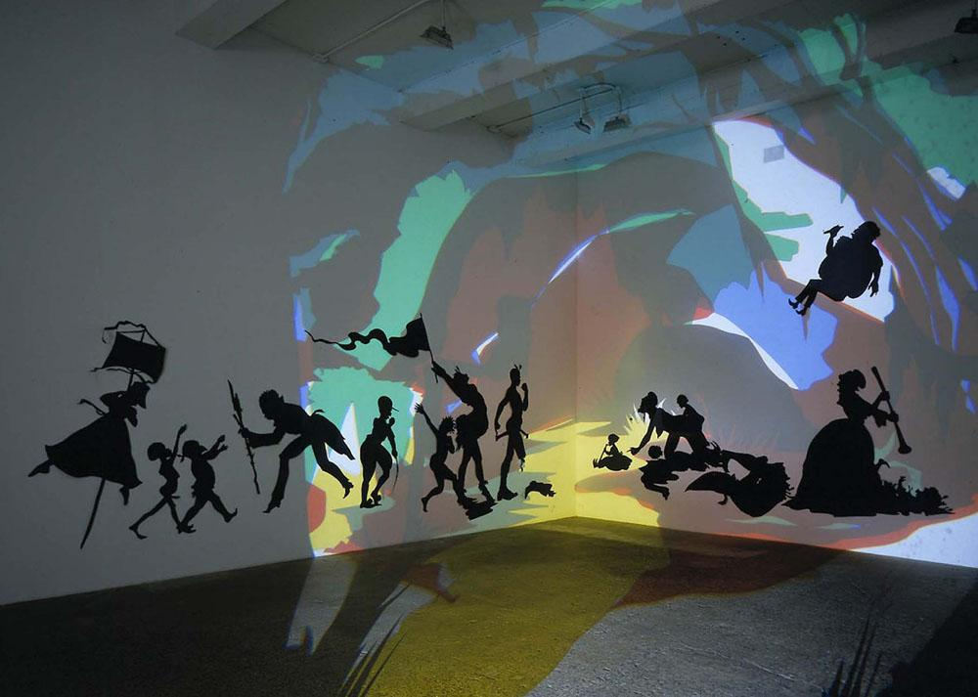
Darkytown Rebellion
Kara Walker. 2001. located in Musee d’art moderne Grand-Duc Jean, Luxembourg. made out of cut paper and uses a wall projection
Darkytown Rebellion depicts black silhouettes on a white wall with a colorful projection on it.
The silhouettes are distinct and have sharp defined lines.
The images are violent and nightmare-like
The projection casts a shadow on anyone who walks by. This makes them look like they’re apart of the art.
There aren't any distinguishing characteristics of the bodies. This eliminates age, gender, and race. With the removal of these traits, people can see the art for what it is.
This piece is meant to reflect the south during slavery.
It also shows the stereotypes put on African Americans.
The eliminations of race and gender shows that people need to judge people for who they are not by what they look like.
About the artist: Kara Walker is an African American artist who became famous because of her paper silhouettes and her common themes of gender and racial stereotypes.

Slide 19
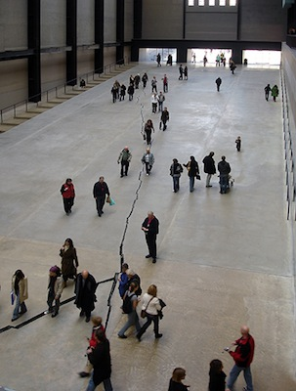
Shibboleth
Doris Salcedo. 2007-2008 C.E. Installation. Tate Modern museum in London. Contemporary.
Shibboleth is the 8th commission in the “Unilever Series”
It begins as a hairline crack, widens to a few inches, and becomes as deep as two feet
The crack is 548 feet long
It was made by opening up the floor and inserting a cast from a Colombian rock face

Slide 20
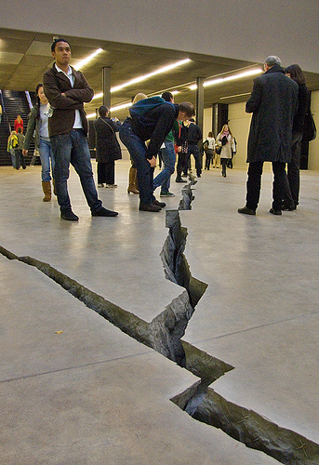
Shibboleth
Doris Salcedo. 2007-2008 C.E. Installation. Tate Modern museum in London. Contemporary.
The definition of a shibboleth is a custom, phrase, or use of language that tests the belonging of a specific social class or group, excluding those who do not fit the requirements of the group
For example, in World War II, American soldiers in the Pacific Islands used the word lollapalooza to distinguish the Japanese enemy soldiers because they were unable to pronounce the word correctly

Slide 21
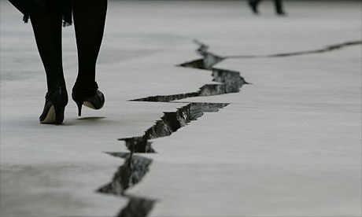
Shibboleth
Doris Salcedo. 2007-2008 C.E. Installation. Tate Modern museum in London. Contemporary.
The crack represents the struggles of immigrants coming to other, more developed countries, such as in Western Europe
The fine line also represents a border between countries, with sharp, jagged edges to show that the foreigners from lesser developed countries and the natives of the more advanced countries are separated by large, strict characteristics that cannot always be changed, such as color of skin or accent

Slide 22
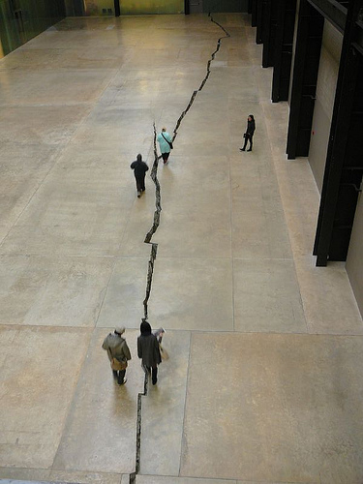
Shibboleth
Doris Salcedo. 2007-2008 C.E. Installation. Tate Modern museum in London. Contemporary.
Shibboleth is meant to be viewed walking from one end of the line to the other; however it is not a straight line or very wide, so to see what is inside the crack, viewers must step diagonally as they walk to change their angle to view the wire mesh inside. This makes the statement that if natives of more developed countries were to simply change their perspective and understand the struggles the immigrant have endeavored, they would realize the two groups deserved to be treated equally
Doris Salcedo is Colombian artist and used her own experiences with racial discrimination as motivation to create Shibboleth

Slide 23
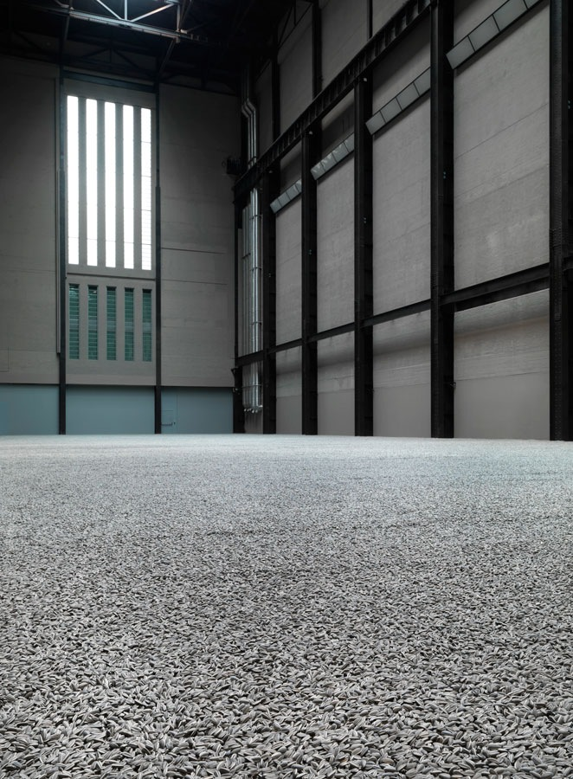
Kui Hua Zi (Sunflower Seeds)
Ai Weiwei. 2010-2011 C.E. Sculpted and painted porcelain. Tate Modern museum in London. Contemporary
There are over 100 million black and white sunflower seeds, and each were hand sculpted and painted over the course of several years
Originally, the exhibit was intended for people to walk on but had to be closed due to health issues and is instead views behind a glass barrier

Slide 24
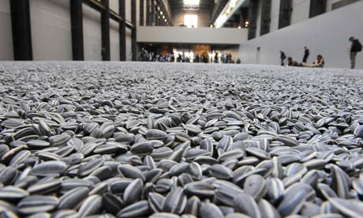
Kui Hua Zi (Sunflower Seeds)
Ai Weiwei. 2010-2011 C.E. Sculpted and painted porcelain. Tate Modern museum in London. Contemporary
Chairman Mao wanted to lead China under his communism rule, trying to convince the public this was a good idea. He built and image as a strong, intelligent, almighty ruler that was the best person fit for ruling China and that he would solve all of their problems.
Ai Weiwei disagreed with his, recognizing the historic problems with communism and not wanting China to suffer the same mistakes

Slide 25
Kui Hua Zi (Sunflower Seeds)
Ai Weiwei. 2010-2011 C.E. Sculpted and painted porcelain. Tate Modern museum in London. Contemporary
He created Kui Hua Zi as a satire of the image Chairman Mao created for himself, with each sunflower seed representing a Chinese citizen. Chairman Mao suggests that he can make China a bright and sunny place under his Communist rule; however, each sunflower seed is made of porcelain to show that they will never bloom, much like Communist China, which will never be able to unite and succeed politically or economically under Chairman Mao’s rule
Creating the Kui Hua Zi is not the only way Ai Weiwei has spoken against Chairman Mao, and he has been to prison several times because of his words and actions, yet still continues to express his views to this day.

