Slide 1
Ch 35 art

Slide 2
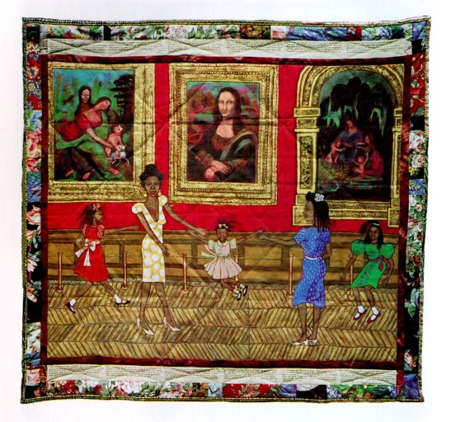
Dancing at the Louvre- Olivia
Dancing at the Louvre, from the series The French Collection, Part I; #1. Faith Ringgold. 1991 C.E. Acrylic on canvas, tie-dyed, pieced fabric border.p. 994
Content: This piece is the first in the series of twelve “story quilts” which tell the fictional story of Willa Marie Simone. This piece shows the children Playing under the masterpieces without paying attention to the things around them. Showing the serious reality of absence of African American and women artist.
Style: Quilt Story, reflecting her knowledge of western art history.

Slide 3
Dancing at the Louvre- Olivia
Analysis: The fictional story of Willa Marie Simone, a young black woman who moves to Paris in the early 20th century is told through text written around the margin of each quilt. Simone is an artist, model, and cafe owner and was created by Ringgold as an alter ego. Ringgold was inspired by the fabric she worked with at home with her mother and she used fabric in many of her art pieces. She is well known for her story quilts, which blur the line between “high art” and “craft” because they combine painting, quilted fabric, and storytelling. In the story quilts, WIlla Maire visits art sites, and modern and European art and artist are used as a framework for rewriting the history of American expatriates. She worked as an activist for social change especially in regard to the American art museum system.

Slide 4
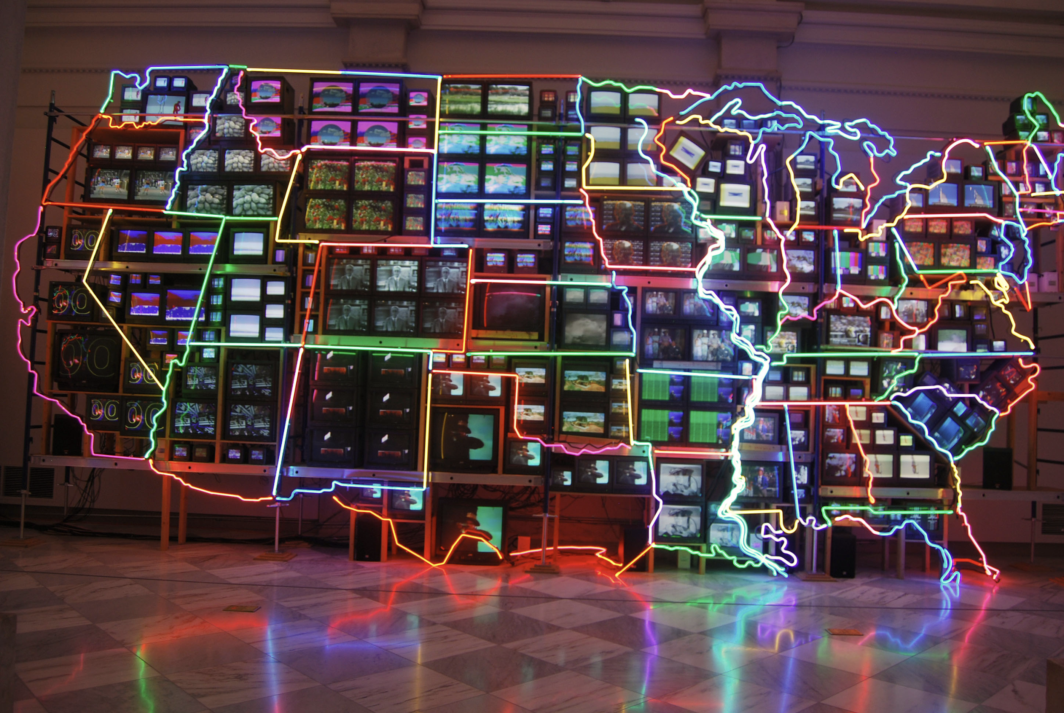
Electronic Superhighway- Olivia
Electronic Superhighway. Nam June Paik. 1995 C.E. Mixed-media installation (49-channel closed circuit video installation, neon, steel, and electronic components).
Content: Large installation map of the United States, arranged with 336 televisions on a scaffold and overlaid with almost 600 feet of neon. There were also 50 DVD players sending multimedia to the screens that filled each state. Some screens were tilted to better fit the state and the television size varies depending on the size of the state. Each group of televisions replays a montage of videos, images, and sounds that Paik associated with each state, such as Kansas playing “The Wizard of Oz” and Oklahoma playing “Oklahoma!”
Style: Contemporary 20th century sculpture

Slide 5
Electronic Superhighway- Olivia
Analysis: When Nam June Paik came to the U.S. the interstate highway system was only nine years old and offered everyone the freedom to travel. The different colors around each state remind us that each state has distinct identities and cultures. Paik was the first to use the term “electronic superhighway” and this piece proposes that media provides us with images and adventures that we used to leave home to discover. Paik also suggest that out picture of America had been influenced by film and television. As an immigrant, seems to reflect his inner attachments to the 50 states, however, it also evokes the notion that America had become consumed by media and television.

Slide 6
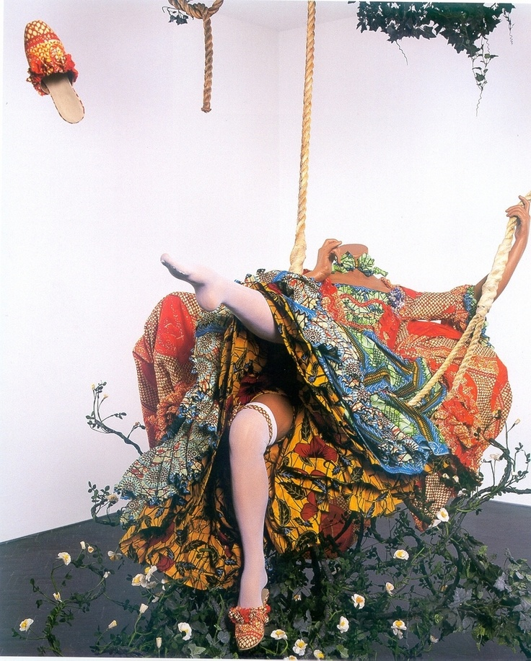
The Swing (After Fragonard)
Yinka Shonibare MBE, The Swing (After Fragonard), 2001 (Tate, London) © Yinka Shonibare
Content: This 3-D recreation of Fragonard’s Rococo painting consists of a life-size headless female mannequin, wearing an 18th century style dress covered in ‘African’ prints. The swing is at its highest point, and the mannequin’s left leg is tilted upwards, flinging her shoe off her foot. The swing is surrounded by flowering brush to its top and bottom
Style: A modern recreation of a French Rococo painting with 'African’ influences shown in the dress.

Slide 7
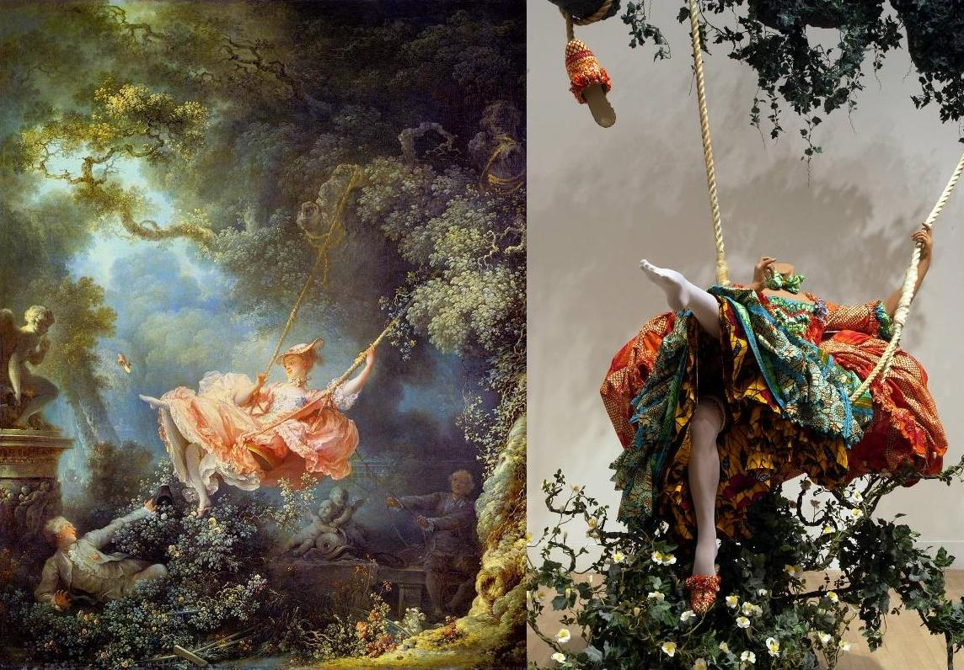

Slide 8
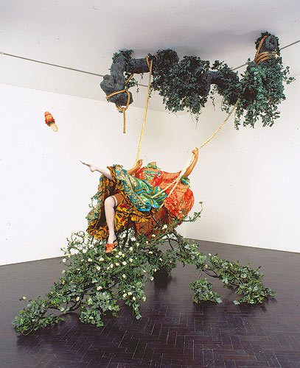
The Swing (After Fragonard)
Analysis: An interesting feature of the subject is the absence of her head, perhaps a nod to the Reign of Terror and the end of the extravagant lives lived by aristocrats during the French Revolution. This reference to the past also shows the increased disparity between social classes during the modern age and might even serve as a warning of what might happen. The decapitated woman also serves as a reminder of the fear consumed by the world after 9/11. Another major difference between Shonibare's sculpture and Fragonard’s painting is the absence of the two male figures. This could be Shonibare’s way of recognizing feminism as a social change from the rococo era to modern times.
‘

Slide 9
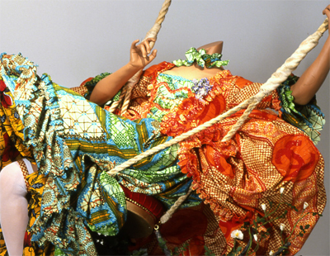
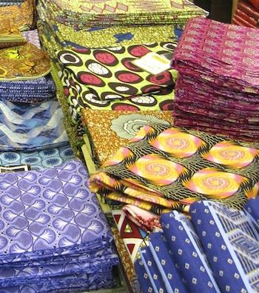
The Swing (After Fragonard)
Analysis (cont’d): Another prevailing symbol is the patterns and fabric on the dress. The fabric is commonly referred to as ‘African’ Dutch wax fabrics, characteristically used by Shonibare. The brightly colored patterns originated as Indonesian motifs that now represent Africa. The fabric was manufactured in Holland and was sold to West African colonies after failing at popularity in South Asian markets. Therefore, these fabrics were created as a result of globalization and European exploration/ imperialism. Their use symbolizes the modern, global world and continuously growing global interactions. It also symbolizes the appropriation of culture into Africa during the age of imperialism and the resulting stereotypes, such as that a fabric not truly African in descent is commonly thought to be authentic.

Slide 10
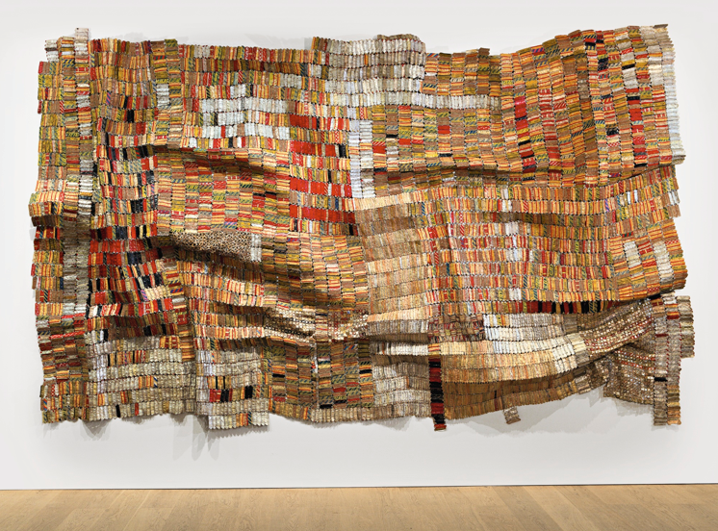
Old Man’s Cloth
El Anatsui, Old Man’s Cloth, 2003, aluminum and copper wire, 16' x 17' 1" / 487.7 x 520.7 cm (Harn Museum of Art, Gainesville, FL)
Content: This piece is a collage made of millions of fragments of flattened liquor bottle labels that hang like a tapestry. It it hung in such a way that the small pieces of metal reflect light from all angles, making the bright colors and patterns all the more interesting. The artist collected the labels himself, and the piece itself is arranged using
copper wire to fasten the bottle caps together. Because of this unique method, it is debated if the piece is a sculpture or a 2-D textile, and is it is a fine art or simply a craft.
Style: Anatsui’s style is abstract and always represents his African heritage. He seeks to break the boundaries drawn by Western artists and to use the broader African understanding of art as a whole.

Slide 12
Old Man’s Cloth
Analysis: The choice in medium, flattened liquor bottle caps, ties the piece to its African origins in a different way than just the style of the piece. Alcohol was traded with Africa during the Columbian Exchange/ transatlantic slave trade. The gold colors refer to Britain’s “Gold Coast” (modern day Ghana) and the movement expressed in the piece represents the waves that carried ships back and forth across the ocean during the slave trade. Anatsui uses the word “cloth” in this piece and many others to recognize the African textile industry On a broader perspective, it is
important to note the piece’s and artist’s impact on African art as a whole. The artist was influenced by a group of “Zaria rebels”, who used the Western techniques learned at college to rediscover their African heritage. He and other artists and professors at the University of Nigeria sought to use African traditions in their modern art. Anatsui differed in his primarily abstract pieces that used color and textures to show African heritage and the effects of Imperialism. The artist’s unique style allows him to contribute greatly to both the world of contemporary art and traditional African art at the same time.

