Slide 1
Dante’s Inferno:
THE NINTH CIRCLE OF HELL
Zack, Katie, Jessica, Dallas, Paige, Luke, Avi, Juliana, Hayden

Slide 2
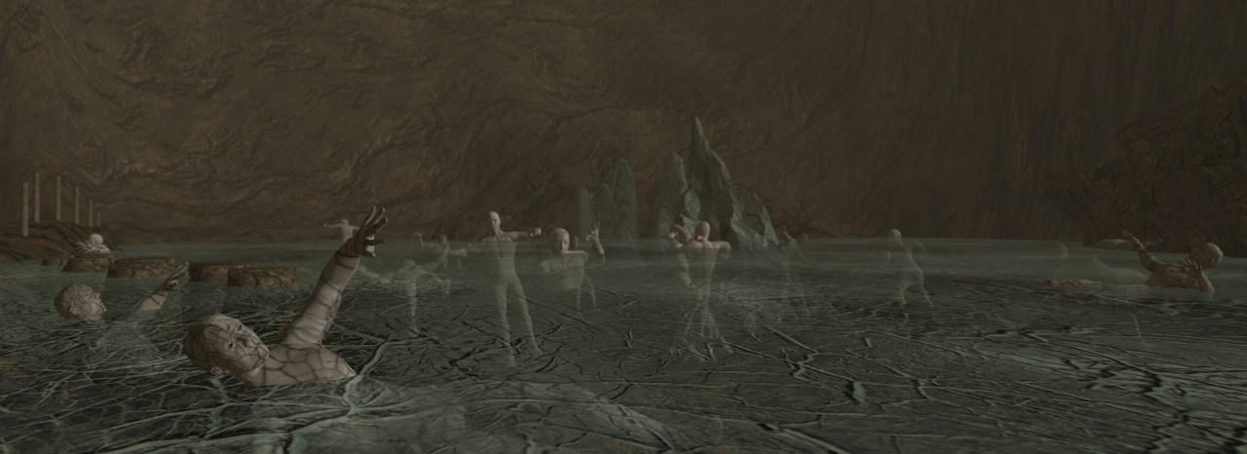
What is the 9th circle ?
most evil of sinners (traitors) are sent here
4 different types
Frozen lake with distorted bodies in various forms
Satan, a fallen angel, resides here
3 heads
chews on Judas, Brutus, and Cassius

Slide 3
Summary
Virgil guides Dante through the last circle of hell which has the greatest effect on Dante because of the gore and inhumane suffering. He witnesses lifeless people scattered around the icy floor and the fallen angel Lucifer, who is now Satan, ripping into bones and flesh as Dante watches in horror. He describes his dreadful experience as a terrible nightmare and he felt as if he had died. The frigid weather and the despair in the air contributes to the atmosphere. Dante grows more and more unsteady until he is brought back to earth. The 9th circle, along with the other levels of hell, helps Dante acknowledge that he must strive to stop his wrongdoings or he could end up in one.

Slide 4
Literary analysis
Dante’s decision to place traders in the ninth and final ring of hell implies that betrayal is the worst possible act against God. When one goes against a voluntary love it is equivalent to going against God. For example, an inhabitant of the fourth circle, Judas Iscariot, directly went against his friend, Jesus Christ. Furthermore, presenting Judas decapitated rather than missing his legs, unlike the other sinners, deepens Judas the ultimate sinner. Due to Julius Caesar having been controversial at the time, and even now, placing Brutus and Cassius (the murderers of Caesar) displays Dante’s personal belief of Rome’s superiority to other nations. Additionally, describing Brutus, Cassius, and Judas as having been similarly mutilated by Lucifer expresses Dante’s view that the church and the government are equal despite their differences.

Slide 5
Interesting Information
from danteworlds
The ninth circle is divided into 4 parts
Caina
named after the biblical Cain (first child of Adam and Eve)
Traitors to their Kin
Antenora
named for the prince Antenor
traitors to one's homeland
Ptolomea
named after when Ptolemy held a banquet for his father-in-law Simon and two of Simon's sons during which he had them all killed
traitors to guests
Judecca
named after the apostle who betrayed Jesus
(satan is here)

Slide 6
Interesting Information from danteworlds
Giants connect floors 8 and 9
the upper halves of their huge bodies tower over the inner edge of circle 8
The giants are from both biblical and classical stories
examples of defiant rebels
Ephialtes was one of the Giants who fought against Jove and the other Olympian gods
Nimrod was viewed as a Giant in the medieval tradition that Dante follows
Antaeus can speak and was born after his brothers waged war against the gods
He is able to lift Dante and Virgil and deposit them on the floor of the ninth circle

Slide 7
Selection #1 – Lines
Line analysis
I stood now where the souls of the last class / (where fear my verses tell it) were covered wholly; / they shone below the ice like straws in glass.
Some lie stretched out; others are fixed in place / upright, some on their heads, some on their soles; / another, like a bow, bends foot to face.

Slide 8
Section #1 Questions
Due to his direct betrayal to Jesus, Judas is shown having his head chewed rather than his limbs. He is designated as the most treacherous sinner because of this action, and therefore is destined to suffer more.
Satan is described as a grotesque and terror-invoking figure. This provides contrast to the general image of Christ, who is perceived as welcoming and kind. The dark description of also emphasizes the absence of Christ’s light within Satan and this circle of hell.
This canto stresses the Medieval belief that actions determine the level of suffering by showing the terrible punishments the worst sinners received.
1.Why does Satan chew on the legs of Brutus and Cassius yet he chews on the head of Judas? (Symbolism analysis)
2.How does this description of Satan tie into the greater allegory and Christian comparisons? (Allegory analysis)
3.Based on this selection, what is the theme of this specific canto? The entire epic? (Theme analysis)

Slide 9
Selection #2 – Lines
Line analysis
In every mouth he worked a broken sinner / between his rake-like teeth. Thus he kept three / in eternal pain at his eternal dinner.
I did not die,and yet I lost life’s breath

Slide 10
Section #2 Questions
1.What is the significance of Hell being frozen over instead of a fiery inferno? / What does it represent? (Symbolism analysis)
2.How does Dante’s reaction to the icy Ninth Circle of Hell contribute to his character overall? (Character analysis)
3.Based on this selection, what is the theme of this specific canto? The entire epic? (Theme analysis)
The ninth circle of hell is frozen rather than fiery because it is furthest away from Jerusalem
It helps him realize that he must change his ways because he does not want to end up the way the people in the ninth circle of hell did.
People who betrayed others end up in an ongoing hell of ice because their mistakes damaged bonds they had. The entire epic’s theme was to learn from mistakes and change before it’s too late.

