Slide 1
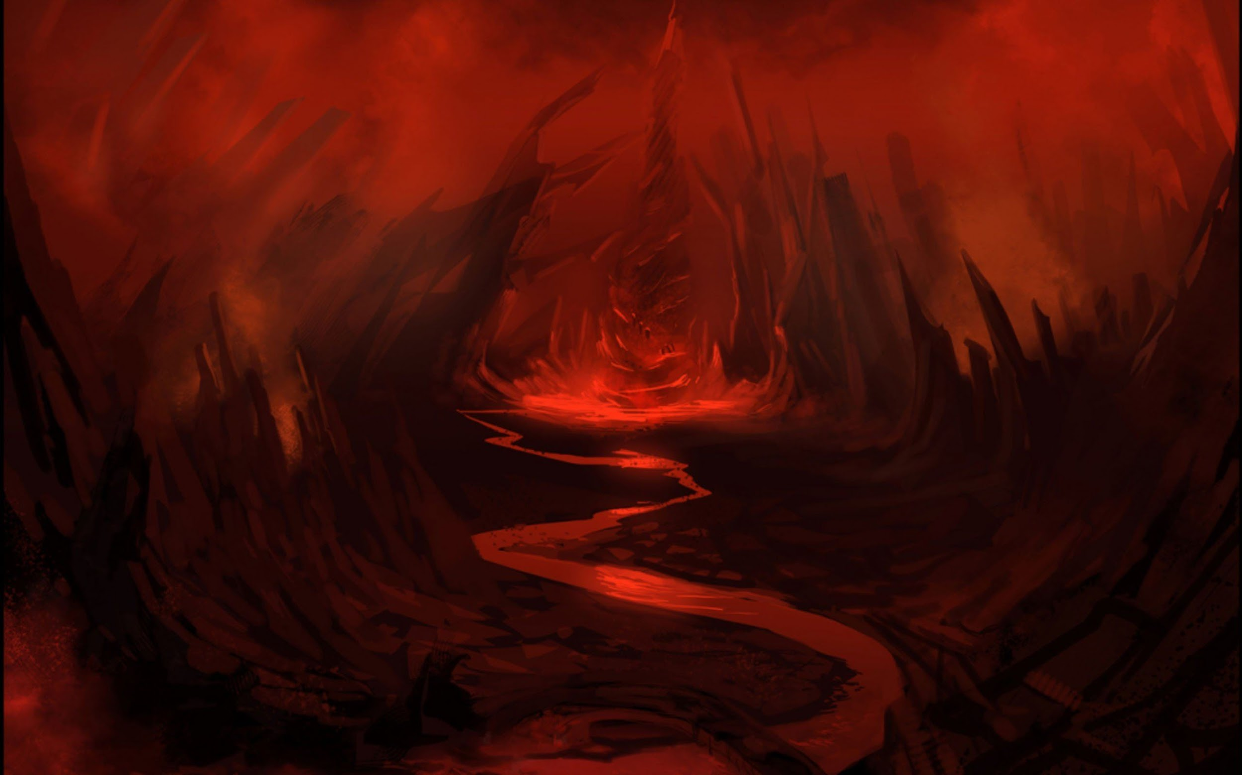
DANTE’S INFERNO: CANTO 1
Joshua, Parker, Amelia, Caroline, Sara, Bella, Peyton, Dawson, Rylee, Abbie

Slide 2
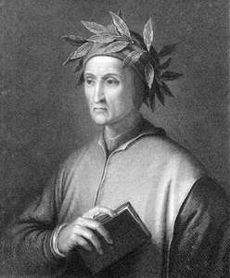
BACKGROUND INFORMATION ON DANTE ALIGHIERI
-He was born in 1265 in Florence, Italy
-Born to a family that was involved in the Florence politics
-Loved and longed for a woman named Beatrice who died in 1290
-Published The New Life three years after Beatrice’s death that detailed his tragic love for her
-He was exiled for life in 1302 by the Florence political faction at the time, the Black Guelphs
-Excommunicated from the Roman Catholic Church
-He completed The Inferno around 1314
-Roamed from court to court in Italy until he died in 1321 from a sudden illness
-Dante’s personal life and writing of The Comedy was greatly influenced by the power struggle between the church and the state for temporal authority

Slide 3
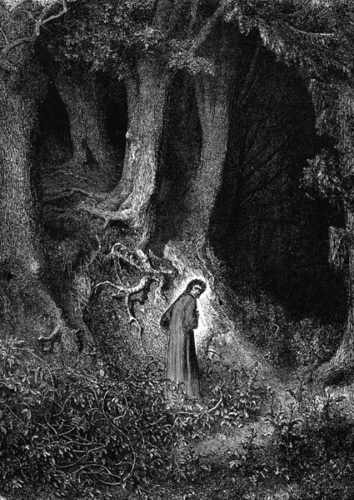
SUMMARY
Dante wakes up confused in the middle of the dark wood. The dark wood is meant to help the reader identify with Dante, as he vaguely describes his surroundings, therefore confusing the readers too. In the woods, he comes across three obstacles: a lion, a leopard, and a she-wolf. These creatures mirror those mentioned in Jeremiah 5:6, and provide ambiguous symbolism, likely for the circles of hell yet to come. He evades these creatures and passes through the woods to the gates of hell. Dante enters the gates of hell with Virgil, who has been ordered to guide Dante by a message sent through a chain of command composed of female saints, the top of which is the Virgin Mary herself.

Slide 4
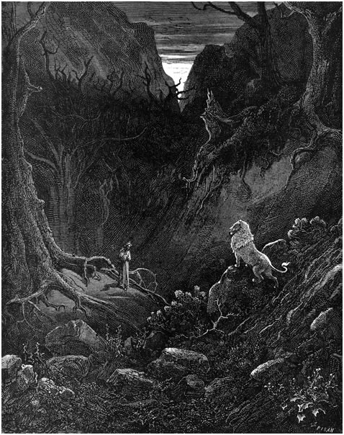
LINES
“For you are my true master and first author,
the sole maker from whom I drew the breath
of that sweet style whose measures have brought me honor.
See there, immortal sage, the beast I flee.
For my soul’s salvation, I beg you, guard me from her,
for she has struck a mortal tremor through me” (Inferno: Canto 1 82-87).

Slide 5
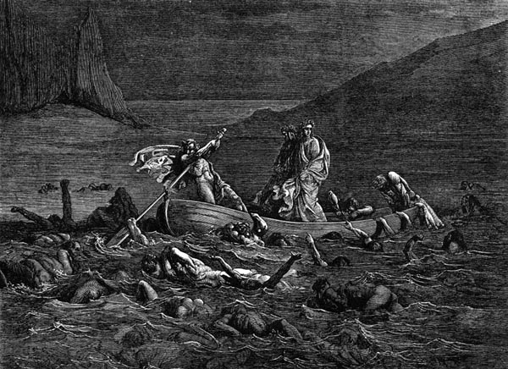
QUESTION
How does Virgil influence Dante, and why does Dante (as an author) choose Virgil to be his character’s guide through hell?

Slide 6
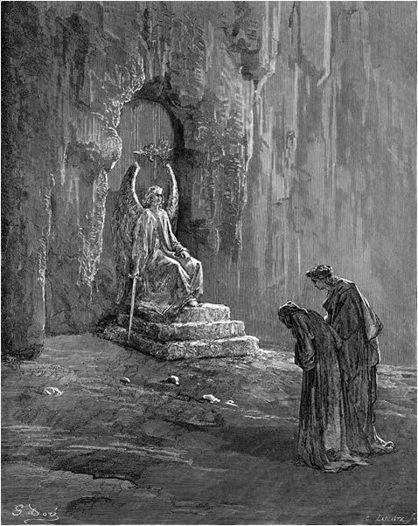
ANALYSIS
Virgil influences Dante’s work because he was the greatest known poet of his time and Dante looks to him for inspiration. Because of this relationship, Dante picks Virgil to be his guide through hell. Dante looks to Virgil for help in avoiding the beasts of the forest, and commends him for his work. In addition to all of this, Dante bases The Inferno off of Virgil’s Aeneid. Virgil is also described as a sort of teacher to Dante in the sense of poetic styles. Last, in the Aeneid Virgil lays out his own version of what the afterlife holds and Dante ultimately modifies this vision for a more Christian orientation, rather than a pagan one (Virgil was a pagan).

