Slide 1
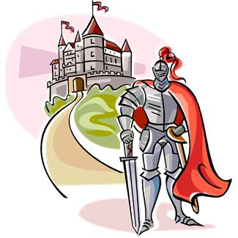
Characteristics of the Medieval Romance
A Tale of High Adventure.
A religious crusade, a conquest for the knight’s lord/king, and/or the rescue of a captive lady (or any combination).

Slide 2
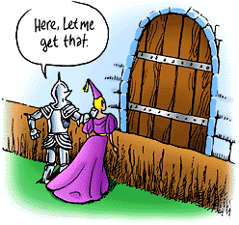
1. Medieval romance usually idealizes chivalry.
Chivalry…
What is this?
Honor, Respect,
Loyalty, Courtesy,
Gentlemanly
Behavior, courage,
Self-less acts.

Slide 3
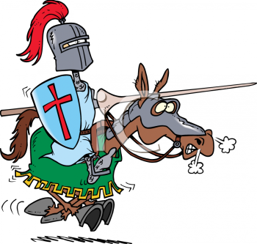
2. Medieval romance idealizes the hero-knight and his noble deeds.
The Hero-knight
Is well respected
And looked up to.
There are usually
High expectations
Of him and he
May have already
Performed some
Chivalrous and
Brave, daring tasks.

Slide 4
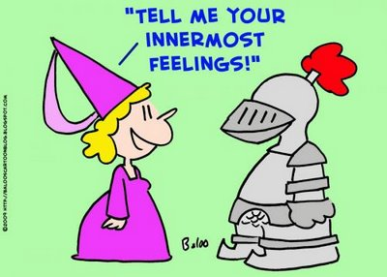
3. An important element of the medieval romance is the knight’s love for his lady, or high regard and respect for women in general.

Slide 5
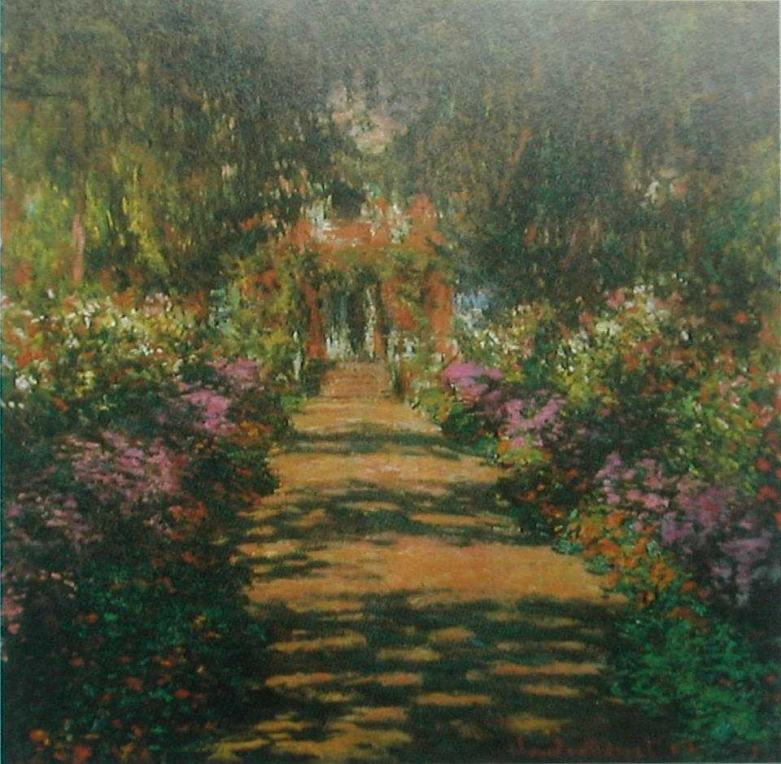
4. The settings of medieval romance tend to be imaginative and often vast and fairytale like.
“Once upon a
Time in a faraway
Land….”

Slide 6
5. Our hero-knight must complete a quest for love or adventure and while doing so will perform daring deeds.

Slide 7
6. Medieval romances have a simple, predictable plot with some inevitable events. “Once upon a time….and they lived happily ever after.”
Inevitable means unavoidable, can’t be stopped.

Slide 8
A Story of Perceval from The Grail by Chretien de Troyes
Perceval is a young man whose mother raised him in isolation after losing her husband and two other sons to chivalric combat. One day, Perceval meets a group of knights, who so impress him that he decides to become a knight himself. He journeys to King Arthur’s court, proves his valor, and is accepted. As part of his training for knighthood, Perceval learns never to ask questions and never to speak until spoken to first. Once his training is complete, Perceval sets out on a quest for the Grail, or holy cup.

Slide 9
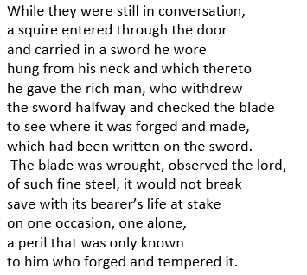
Excerpt from Perceval

Slide 10
Don Quixote: A Renaissance Parody of Medieval Chivalric Tales

Slide 11
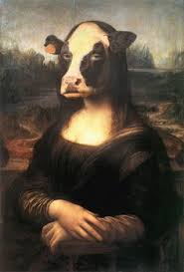
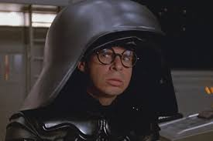
Definition of Parody
A parody is an imitation of another work of literature done to entertain and/or make a serious point.
Often a parody uses exaggeration or inappropriate subject matter to make something that is serious seem laughable.

Slide 12
Connection to Humanism
Remember that the humanists of the Renaissance considered people of the Middle Ages to be uncultured and unenlightened.
That’s why we often refer to the Middle Ages as the Dark Ages.
Miguel de Cervantes Saavedra of Spain supported this belief.
Find out more about Cervantes. In your textbook, read pp. 768-769.

Slide 13
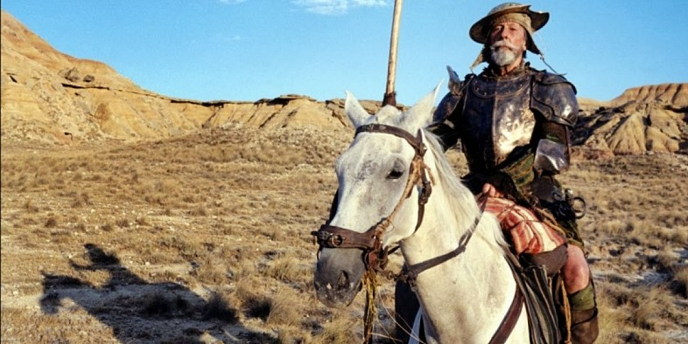
Don Quixote
Read Chapter I in your textbook pp. 770-777.
Answer the Literary Analysis: Parody questions on p. 770 and 777.
Answer #3 & 4 on p. 777.

Slide 14
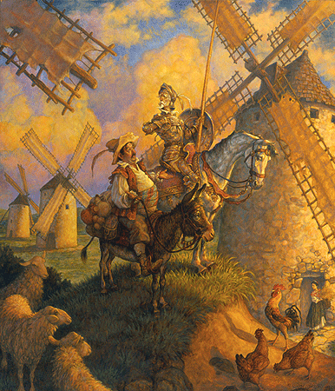
Don Quixote hires a squire
Read Chapter VII and VIII in your textbook pp. 778-784.
Answer the Literary Analysis: Parody questions on p. 778 and 782.
Answer #1 on p. 785.

