Slide 1
Think like an historian:
H- Historical Context. Explain the broader setting, time period, and social structures that surround the piece.
A- Audience. Identify the audience of the piece. To/for whom was the piece created?
P- Purpose. Identify the purpose or function of the piece.
P- Perspective. From whose perspective was the piece created? What was the motivation for creating the piece?
Y- Why? Explain why the piece was created, what it tells us about the creator, and how it affected the audience.

Slide 2
Early Egyptian Art
Ancient Egypt produced art that is monumental and unchanging. Egyptian art was created for divine kings and for the ka of the dead. Egypt counted on the pharaoh to keep order, prosperity, and stability. The culture prized the regular and predictable: the journey of the sun; the annual flooding of the Nile; and the voyage to the afterlife. It is this regularity that establishes standard forms of depicting the human figure and influences the subject matter in art for a couple of thousands of years.
Characteristics:
Marked by CONSERVATISM: rules, conventions established in early period persist for 3000 years. There is little fluctuation, with the exception of the Amarna Period under Akhenaton.
Architecture on a monumental scale- funerary monuments and temple complexes.
Stress placed on deifying the pharaoh. Monumental works created to show their power and authority.
The use of registers, with the bottom line as the ground line was used as the means to tell narratives.
Art is generally a combination of text and images.
On flat surfaces, things may be seen from the front, the side, or above.
Sculptural works, carved from blocks of hard stone, are usually blockish, with a dominance of vertical and horizontal lines to communicate permanence and stability.
High rank is portrayed with strict conventions. Everyone else is portrayed naturalistically.

Slide 3
Conventions used for depicting the pharaoh or the pharaoh's family:
Stylized and Idealized, intended to look divine.
In prime of life.
Broad shoulders, narrow hips.
Some muscle definition, but not "too much“
Calm facial expression.
Hieratic perspective/scale.
Flat surface: composite view (face, hips, legs and feet in profile, torso frontal).
Sculpture: facing strictly frontal.
Poses: either sitting with both feet on the ground, standing with one foot a few inches forward, or striding forward.

Slide 4
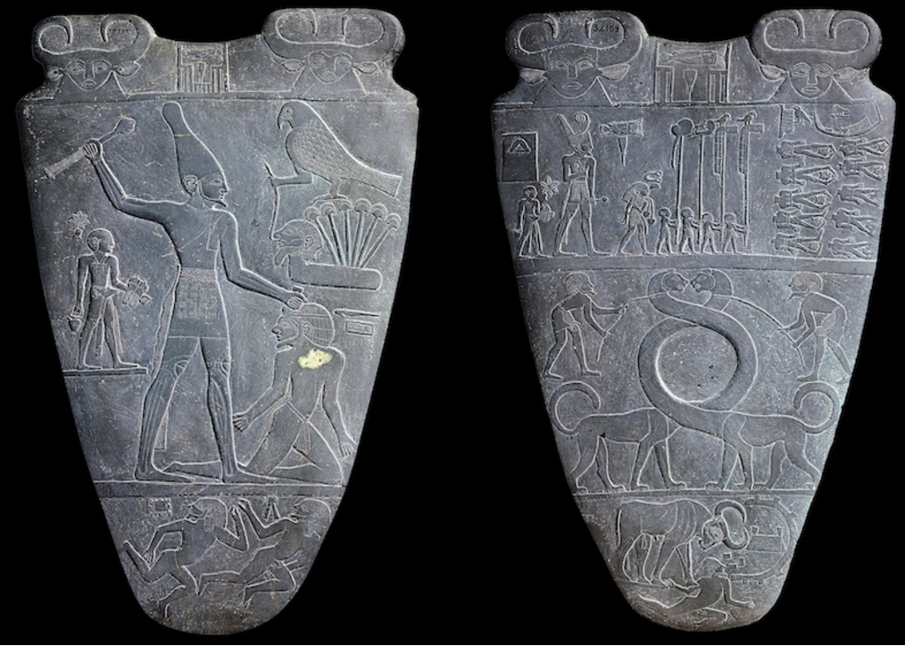
Palette of King Narmer. Predynastic Egypt. c. 3000–2920 B.C.E. Greywacke
On the back, King Narmer with a mallet beats down the defeated foe. A servant holds his sandals, as this is a “sacred” act. Defeated enemy lie beneath his feet.
On the front, the bodies of the defeated troops are seen from above with their heads placed between their legs.
The palette contained eye make-up. Harnessed lions with elongated necks create a circle used to hold the make-up.
https://www.khanacademy.org/humanities/ancient-art-civilizations/egypt-art/predynastic-old-kingdom/a/palette-of-king-narmer

Slide 5
Created using a subtractive technique. Incised images create low relief.
Composite view shows human figures with shoulders forward (frontal), hips slightly side ways, head sideways, and feet sideways.
This document begins to show the use of art in documenting historic events through narrative art. This pre-dynastic story tells about the unification of Egypt under the hands of King Narmer. Prior to King Narmer, upper and lower Egypt were separate places. King Narmer’s name appears at the top of the stone in ancient calligraphy and
he is placed in the middle of the stone and depicted larger than the rest of the figures in hierarchal scale.
The animals in the piece resemble gods and their characteristics. The presence of the gods in the piece show that the people are doing the work of the gods as they guide in animal form.
The palette was clearly intended to be read. There are both ceremonial and functional palettes found from this time period; however, the palette of King Narmer in particular is ceremonial. The functional palettes were used to grind up eye make-up not only used for beautification but for sun protection as well.

Slide 6
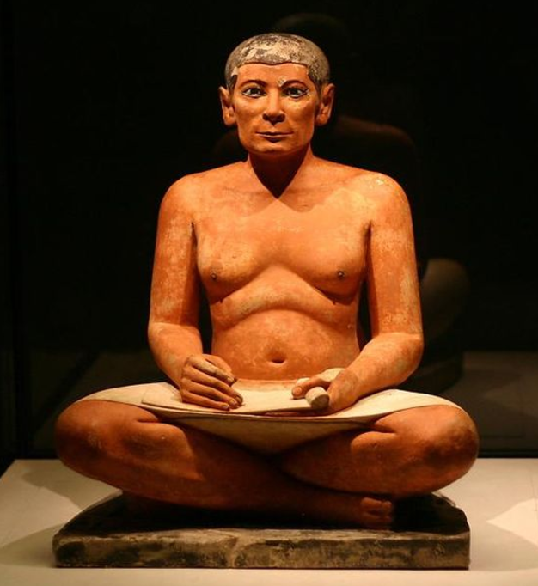
Seated scribe. Saqqara, Egypt. Old Kingdom, Fourth Dynasty. c. 2620–2500 B.C.E. Painted limestone.
The sculpture is made of painted limestone. The skin tone is the color of the raw stone.
The sculpture’s focus is someone with lesser status.
The work is an exception to some of the Egyptian art norms. Showing a normal body with sagging chest is unusual in Egyptian culture art.
The work is naturalistic with individualized, defined features where as the art of the pharaoh is more idealistic.
The sculpture has a stiff frontal pose.
The ultimate purpose of the sitting scribe is unknown by historians. It is thought it could perhaps be a funerary piece put in an important figure’s tomb to assure comfort in the after life. The main reason this piece is studied is because of its unique focus on a person of lower status and the early development of the human figure.
https://www.khanacademy.org/humanities/ancient-art-civilizations/egypt-art/predynastic-old-kingdom/v/the-seated-scribe-c-2620-2500-b-c-e

Slide 7
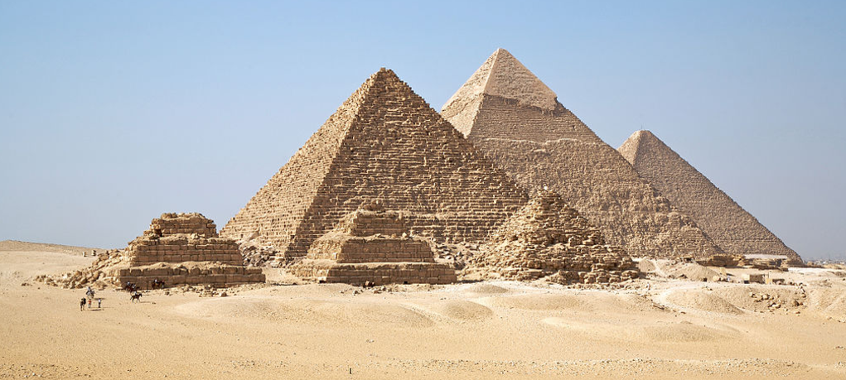
Great Pyramids (Menkaura, Khafre, Khufu) and Great Sphinx. Giza, Egypt. Old Kingdom, Fourth Dynasty. c. 2550–2490 B.C.E. Cut limestone.
https://www.khanacademy.org/humanities/ancient-art-civilizations/egypt-art/predynastic-old-kingdom/a/old-kingdom-the-great-pyramids-of-giza

Slide 8
Purpose: The pyramids were constructed as funerary temples to hold the mummified bodies of pharaohs and the riches they would need for a comfortable afterlife. The pyramids underscore the importance of death in Egyptian culture.
Architecture:
The corners of the pyramids align with the cardinal directions.
Pyramids face the rising sun.
The sloped sides, created by stone casings, reflect the rays of the sun.
Egyptian laborers stacked the huge limestone blocks so tightly that no mortar was needed. This design proves that Egyptian had an impressive and advanced understanding of engineering.

Slide 9
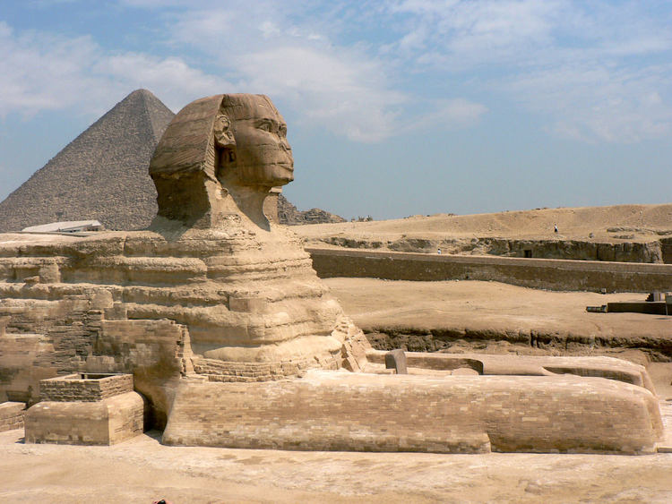
Did you know the Great Sphinx is not a “sphinx” at all? The Greeks mistook the pharaoh’s headdress for hair, and assumed the Egyptians also had a mythological tradition of a monster with a woman’s head, a lion’s body, and the wings of an eagle.
Instead, the Horemakhet (Horus of the Horizon) is probably Khafre’s head on the body of a recumbent lion.

Slide 10
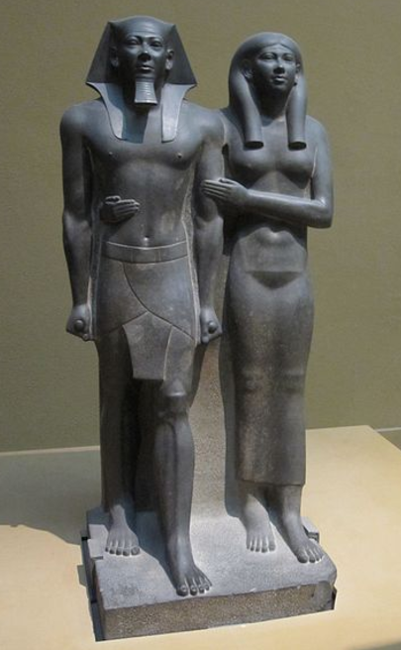
King Menkaura and queen. Old Kingdom, Egypt. Fourth Dynasty. c. 2490–2472 B.C.E. Greywacke
The one-foot forward position resembles the 'ready for action' attitude of a successful pharaoh. The position shows power and significance. The statue is made of hard, dense stone saved for only wealthy citizens, statues made from this stone were intended to last.
The detail and obvious effort put into this statue and many other funerary statues show the Egyptians obsession with death and the afterlife and the importance of death. Most pharaohs started having their funerary statues carved at the beginning of their rein to assure their comfort in riches in the afterlife.
In these statues individual style was not appreciated or allowed, an artist’s talent was based upon their ability to copy the traditional, godlike / idealistic image of a pharaoh with no innovation. During ancient Egypt artwork, the cannon of proportions made an appearance, this is the first known rule of proportions. This rule helped artists create idealized size proportions that never varied from piece to piece.
Another important aspect of this statue is the wet drapery on the queen figure. It shows her royal status, but is slightly provocative at the same time. It may have has fertility connotations.
https://www.khanacademy.org/humanities/ancient-art-civilizations/egypt-art/predynastic-old-kingdom/a/king-menkaure-mycerinus-and-queen

Slide 11
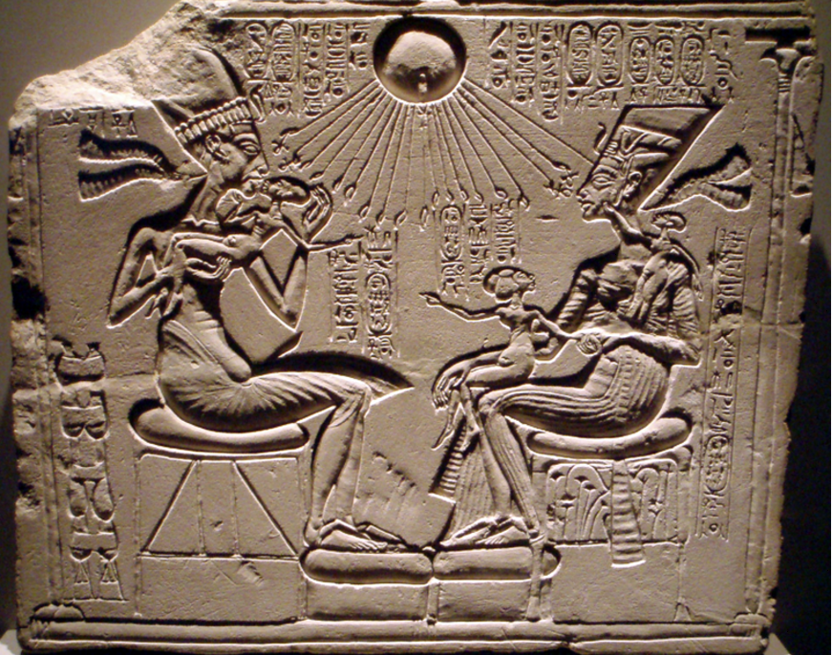
Akhenaton, Nefertiti, and three daughters. New Kingdom (Amarna), 18th Dynasty. c. 1353–1335 B.C.E. Limestone.
The Pharaoh Akhenaton is depicted with his wife in an intimate family scene. The three small female figures are the daughters of the pharaoh. The pharaoh and his wife, Nefertiti, are depicted kissing their children and loving them. This intimate, natural view of the family and humanity is very different from Old Kingdom artworks.
The pharaoh is depicted basking in the rays of the sun god Aten. The concept of monotheism was new, and the worship of Aten was radical.
https://www.khanacademy.org/humanities/ancient-art-civilizations/egypt-art/new-kingdom/v/house-altar-depicting-akhenaten-nefertiti-and-three-daughters

Slide 12
Akhenaton, Nefertiti, and Three Daughters was created using a subtractive technique (incised). A bas relief is a sculptural relief in which the projection from the surrounding surface is slight and no part of the modeled form is undercut.
The elongated figures and the naturalistic-more humanistic scenes mark the Amarna style.
Because most of ancient Egypt's artifacts were crafted with stone, we today still see many of the works of art. Stone lasts, thus the artifacts crafted on stone last.
Akhenaton believed in only one god, switching the kingdom from a polytheistic culture to a monotheistic culture. This belief allows for Akhenaton to be the only higher power.
The symbols at the end of the sunrays are portraying the giving of life from the one and only god Aten.

Slide 13
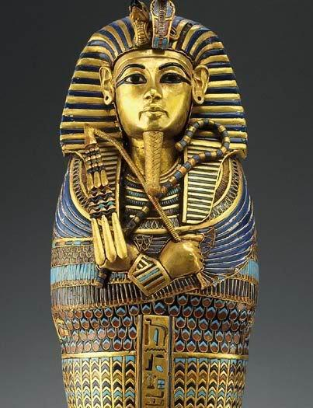
Tutankhamun’s tomb, innermost coffin. New Kingdom, 18th Dynasty. c. 1323 B.C.E. Gold with inlay of enamel and semiprecious stones.
https://www.khanacademy.org/humanities/ancient-art-civilizations/egypt-art/new-kingdom/a/tutankhamuns-tomb

Slide 14
King Tutankhamun was in retrospect a fairly mild pharaoh, he died young (age 18); however, when his tomb was found completely intact, King Tut became a huge symbol of Egypt. The discovery of the tomb allowed historians to gain more understanding of the burial process and the importance of the afterlife. Before King Tut's tomb, all the funerary temples found had been looted. Because King Tut was less significant, his tomb was placed behind a more recent pharaoh’s tomb; therefore, it had been protected from looters. The insight the tomb brought to historians about the afterlife in Egypt is enormous.
The tomb is a rock cut tomb. The innermost coffin is one of the three layers of coffins (all gold).
The inner coffin, or sarcophagus, housed the mummy. This coffin was the most elaborately decorated. It is made of beaten, modeled gold inlayed with other precious and semi-precious stones. It is inscribed with hieroglyphics
King Tutankhamen holds the crook and flail and wears the nemes, symbols of the Egyptian pharaoh.
He is depicted with crossed arms, which is typical of royal burials.

Slide 15
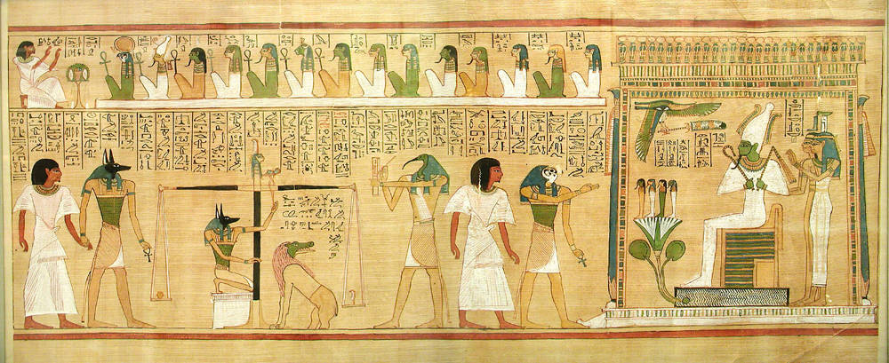
Last judgment of Hu-Nefer, from his tomb (page from the Book of the Dead). New Kingdom, 19th Dynasty. c. 1275 B.C.E. Painted papyrus scroll.
Take notes from the Khan Academy video.
https://youtu.be/WceVwMdN0eE

