Slide 1
Huang He River Valley Xia - Shang Dynasty Rise and Fall

Slide 2
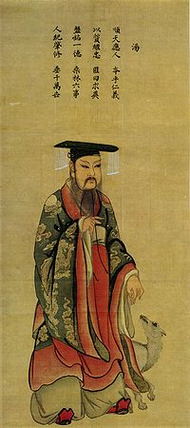
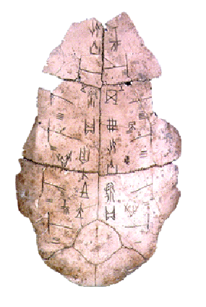
Huang He River Valley Shang Dynasty
T'ang, overthrew the decadent emperor Jie, the last of the Xia dynasty
Claimed Jie’s lack of virtue meant he lost the ability to govern his people
Emperors were seen as intermediaries between Di (supreme deity/sky god), dead ancestors, and Humankind
Emperor made government decisions and led religious rituals
Valued the predictions of Shamans/ Priests
Pictograms found on oracle bones
Oracle bones designed to predict future, help rulers govern
Basis of modern Chinese script
Each character stands for an idea not a sound
over a 1,000 characters → barely literate.
Scholars knew around 10,000 characters.
Shang known as the Bronze Age of China
Bronze- source of Shang art, weapons, and tools
Ended c.1050 BCE, Zhou conquerors invaded capital
claimed to overthrow the Shang for moral reasons
Said heaven no longer wanted Shang king to rule
Blamed the Shang’s downfall on king
drinking, indulgent lifestyle, and immoral behavior
Cautionary tale to kings/emperors for years to come
Emperor T’ang

Slide 3
The Mandate of Heaven
Mandate of Heaven - the divine approval that is the basis of royal authority
The new dynasty establishes peace and is considered to have the mandate of Heaven.
New dynasty gains power and claims to have the Mandate of Heaven.
Gradually, the dynasty declines and power grows weak.
Dynastic Cycle
New dynasty emerges as old dynasty is overthrown .
Disasters occur and the dynasty grows weaker.
Dynastic Cycle -
the historical pattern of the rise, decline, and replacement of dynasties
Old dynasty is seen as having lost the Mandate of Heaven and rebellions break out.
Notes:
*
Gregory Wolfson with Tobin and Erica
*

Slide 4
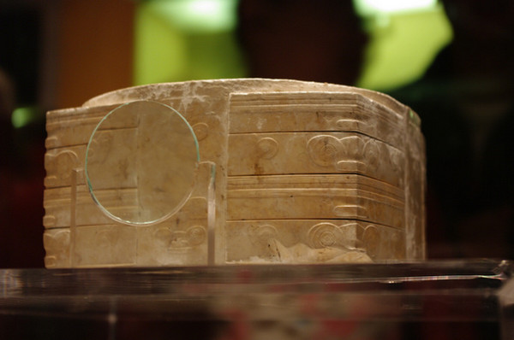
Jade cong. Liangzhu, China. 3300 – 2200 B.C.E. Carved jade.
Greg Kf (http://www.gnu.org/copyleft/fdl.html)], via Wikimedia Commons

Slide 5
A cong is a form of ancient Chinese jade artifact. The cong is one of the main types of jade artifact of the Liangzhu culture (about 3000-2000 BC) around Lake Tai in Jiangsu province. In form, a cong is a tube with a circular inner section and squarish outer section. The outer surface is divided vertically or horizontally. The outer faces are sometimes decorated with mask-like faces.
Although generally considered to be a ritual object of some sort, the original function and meaning of the cong are unknown. Later writings speak of the cong as symbolizing the earth, while the bi represents the heavens. The square represents the earth and a circle represents the heavens. (Wikipedia)
Half-human, half-animal images with large eyes, flat noses, and rectangular mouths were found carved in low relief. The meaning of the mask like creatures is hard to be determined, but could possibly be a representation of deities or ancestors.

Slide 6
Optional Historical Videos
– History Channel video on Fire
– History Channel video on Farming
– Crash Course Video #1 Neolithic Revolution
– Guns, Germs and Steel: Stone Age Crops
If you would like more information about this historical period, take notes while watching these videos for a greater understanding of the topics we discussed in class for Unit 0A.

