Slide 1
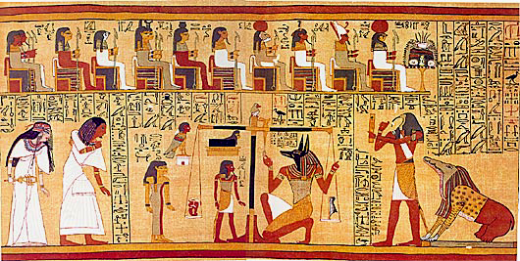
Egyptian Book of the Dead

Slide 2
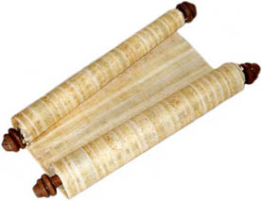
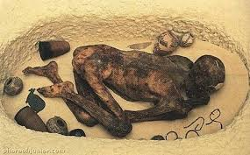
What was the Book of the Dead?
The Book of the Dead was a collection of spells and illustrations written on a papyrus roll. The papyrus roll was put inside a hollow statue, or sometimes wrapped within the mummy wrappings, and placed in the tomb with all the other things which the dead person would need for the afterlife.

Slide 3
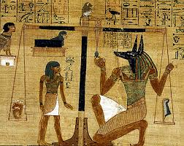
Why did an ancient Egyptian need the Book of the Dead in their tomb?
The spells and illustrations in the Book of the Dead gave a dead person the knowledge and power they needed to journey safely through the dangers of the netherworld (a place the dead went immediately after death) and the gods and hostile creatures they would meet and the critical ‘weighing of the heart’ judgement to decide if the dead person was allowed into the afterlife. They also spoke of the ultimate goal of every ancient Egyptian – eternal life.

Slide 4
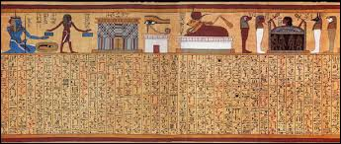
What special powers did the spells provide?
Some spells gave the dead person the power to control their body and keep it safe. Some spells allowed the dead person to turn into different animals making it easier to travel through the netherworld. Some spells gave the dead person information which they would need to repeat at certain points on their journey. Some spells gave the dead person protection against hostile creatures.

Slide 5
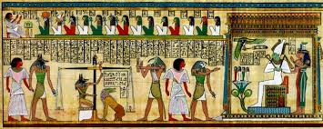
How were Egyptians Judged in the Afterlife?
The greatest test which the dead person faced was the judgement in the Hall of the Two Truths. Here the gods reviewed the dead person’s behavior during their life, to decide whether or not they deserved to enter the afterlife. First the dead person addressed 42 deities by name, declaring to each that they were innocent of a specific offence such as theft or telling lies.

Slide 6
How were Egyptians Judged in the Afterlife?
The ancient Egyptians believed the heart was the centre of a person’s being and the location of their mind, so next the dead person’s heart was weighed against an image of Maat, the embodiment of order, right and truth. A perfect balance indicated a life well spent; the god Thoth returned the heart to its owner and declared them ‘true of voice’ before they were welcomed to paradise by the god Osiris. If the heart was heavier than Maat, its owner was condemned, their heart eaten by the monstrous Devourer and their existence ended. All copies of the Book of the Dead show a successful outcome.

