Slide 1
HUMANITIES
Integrating
AP World History, AP Art History, and Honors World Literature
Shannon Herndon
Stephanie
Tatum

Slide 2
HUMANISM Spirit of the Age
Renaissance movement based on the literature and ideas of Ancient Greece and Rome, such as the worth of each individual. Renaissance scholars refer to humanism as the “Spirit of the Age.”
Historians define Renaissance Humanism in several ways:
Early Humanists
Studied classical Greek and Roman writers (Cicero and Virgil)
Studied old manuscripts
Held interest in classical learning
Fascinated with ancient times
1st

Slide 3
HUMANISM
2nd
Later Humanists
Developed a general critical (questioning/ skeptic) spirit
Believed in achievement and education
Adopted a secular (worldly) view
Achieved greatness in literature and the arts
Emphasized individualism, the dignity and worth of the individual person
Championed the idea of human improvement, that people should develop their talents through many activities: politics, sports, and the arts
A “Renaissance” man would have these characteristics and broad interests.
The term “humanities” originates from this era.

Slide 4
HUMANISM
Northern European Christian Humanists
Studied original texts of the Church (Hebrew and Greek)
Desired to reform the Church
Challenged long-accepted traditions, assumptions, and institutions.
As they made all sorts of unsettling discoveries, it further validated their desire to challenge and question nearly everything---even long-standing church traditions.
3rd

Slide 5
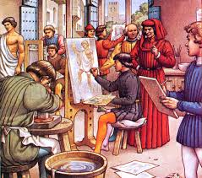
Humanist Cliques ☺
1480s, Florence, Italy - artists and intellectuals gathered together in the courts of princes or rich families such as the Medicis.
Made it their mission to recreate the past and relive it through translating and comprehending the classical works.

Slide 6
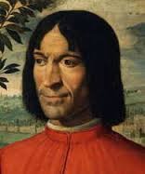
Humanist Cliques ☺
Lorenzo the Great (Medici) assembled groups of humanists, philosophers and artists to form a literary society who interpreted works and formed ideas that were then translated by artists, painters, goldsmiths and musicians.

Slide 7
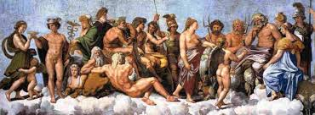
Humanist Cliques ☺
Italians wanted to recapture the glory of Rome
Convinced of the superior wisdom of the ancients - classical legends must contain profound and mysterious truth
Represented more than fairy-tales

Slide 8
EKPHRASIS
One artistic form emulates another artistic form
The relationships of the arts, most specifically painting and poetry, was related to a famous dictum in Horace's Ars Poetica, "ut pictura poesis," or literally "As painting so is poetry."
Popular in Renaissance literature
Natural result of studying ancient texts

Slide 9
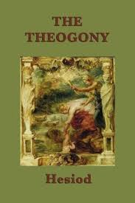
EKPHRASIS
Lorenzo’s clique studied Hesiod’s Theogony which contains a description of the birth of Aphrodite.

Slide 10
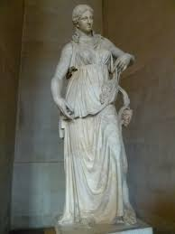
Theogony of Hesiod ca. 700 B.C.
His son reached out from ambush
with his left hand, and in his right he held the sickle,
long and serrated and the genitals of his father 180
he quickly reaped and threw them behind his back
to be carried away. But they did not flee from his hand fruitlessly.
As many drops of blood spurted forth,
all of them Gaia received. In the revolving years,
she bore the powerful Erinyes, and great Giants, 185
gleaming in their armor, holding long spears in their hands,
and the nymphs whom they call the Ash Tree Nymphs across
endless Gaia. As soon as Kronos lopped off the genitals
with the sickle, they fell from the mainland into the much-surging sea, so that the sea
carried them for a long time. Around them a white 190
foam from the immortal skin began to arise. In it, a maiden
was nurtured. First, she drew near holy Kythera,
and from there she arrived at Kypros surrounded by water.
From within, a majestic and beautiful goddess stepped, and
all around grass grew beneath her slender feet. Aphrodite 195
[foam-born goddess and fair-wreathed Kythereia]
gods and men call her because she was nurtured in foam.
But they call her Kythereia because she happened upon Kythera,
and Kyprogenes because she was born in much-surging Kypros,
and Philommeides because she appeared out of genitals. 200

Slide 11
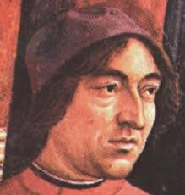
Ekphrasis
Lorenzo had the story of Venus’ birth set to verse by one of his favorite humanist poets, Angelo Poliziano.

Slide 12
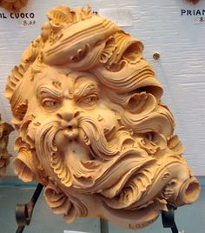
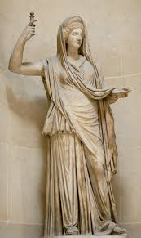
Poliziano’s Giostra ca. 1475-8
XCIX 99
In the stormy Aegean, the genital member is seen to be received in the lap of Tethys, to drift across the waves, wrapped in white foam, be- neath the various turnings of the planets; and within, both with lovely and happy gestures, a young woman with nonhuman countenance, is carried on a conch shell, wafted to shore by playful zephyrs; and it seems that heaven re- joices in her birth.
C 100 You would call the foam real, the sea real, real the conch shell and real the blowing wind; you would see the lightning in the goddess's eyes, the sky and the elements laughing about her; the Hours treading the beach in white garments, the breeze curling their loosened and flowing hair; their faces not one, not different, as befits sisters.

Slide 13
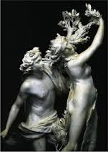
CI 101 You could swear that the goddess had emerged from the waves, pressing her hair with her right hand, covering with the other her sweet mound of flesh; and where the strand was imprinted by her sacred and divine step, it had clothed itself in flowers and grass; then with happy, more than mortal features, she was received in the bosom of the three nymphs and cloaked in a starry gar- ment.
CII 102 With both hands one nymph holds above the spray-wet tresses a garland, burning with gold and oriental gems, another adjusts pearls in her ears; the third, intent upon those beautiful breasts and white shoulders, appears to strew round them the rich necklaces with which they three girded their own necks when they used to dance in a ring in heaven.

Slide 14
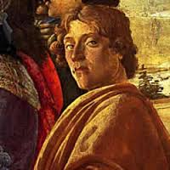
Ekphrasis
Poliziano’s poem filtered through to painter Sandro Botticelli who scrupulously followed the text in order to create a painting.

Slide 15
Sandro Botticelli ~ Birth of Venus Alessandro di Mariano Filipepi (born 1445, Florence - died May 17, 1510, Florence)
Uffizi Gallery, Florence Italy

Slide 16
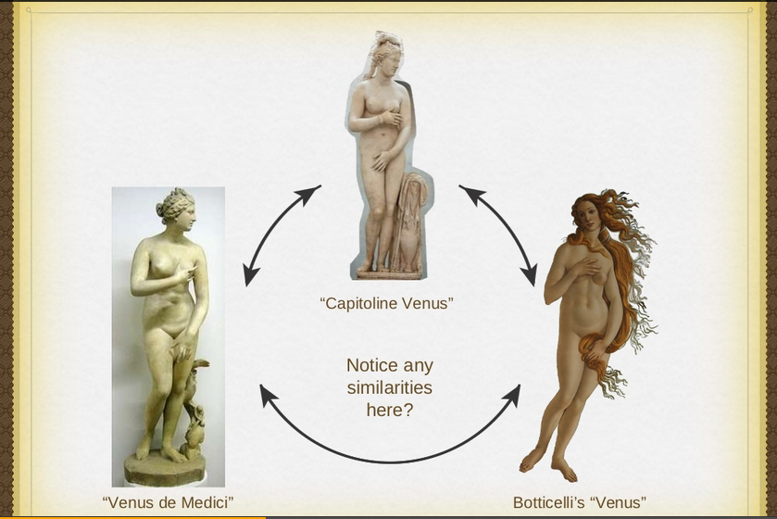
Ekphrasis

Slide 17
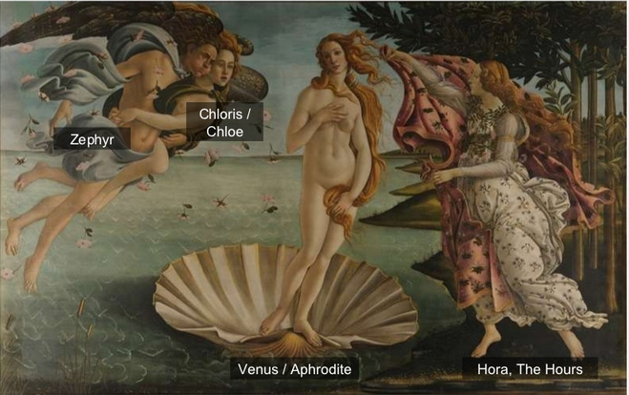

Slide 18
YOUR TURN
Give “VOICE” to a piece of art, history, or literature—YOU decide.
Choose an inspiration and create an EKPHRASIS of your own:
Historical article > poem or drawing
Artistic piece > history or story
Literary text > drawing or history

Slide 19
Willow Poem by William Carlos Williams
It is a willow when summer is over, a willow by the river from which no leaf has fallen nor bitten by the sun turned orange or crimson. The leaves cling and grow paler, swing and grow paler over the swirling waters of the river as if loath to let go, they are so cool, so drunk with the swirl of the wind and of the river— oblivious to winter, the last to let go and fall into the water and on the ground.

Slide 20
Black Boys Play the Classics by Toi Derricotte
The most popular “act” in
Penn Station
is the three black kids in ratty
sneakers & T-shirts playing
two violins and a cello—Brahms.
White men in business suits
have already dug into their pockets
as they pass and they toss in
a dollar or two without stopping.
Brown men in work-soiled khakis
stand with their mouths open,
arms crossed on their bellies
as if they themselves have always
wanted to attempt those bars.
One white boy, three, sits
cross-legged in front of his
idols—in ecstasy—
their slick, dark faces,
their thin, wiry arms,
who must begin to look
like angels!
Why does this trembling
pull us?
A: Beneath the surface we are one.
B: Amazing! I did not think that they could speak this tongue.

Slide 21
Cabezón By Amy Beeder
I see you shuffle up Washington Street
whenever I am driving much too fast:
you, chub & bug-eyed, jaw like a loaf
hands in your pockets, a smoke dangling slack
from the slit of your pumpkin mouth,
humped over like the eel-man or geek,
the dummy paid to sweep out gutters,
drown the cats. Where are you going now?
Though someday you'll turn your gaze
upon my shadow in this tinted glass
I know for now you only look ahead
at sidewalks cracked & paved with trash
but what are you slouching toward—knee-locked,
hippity, a hitch in your zombie walk, Bighead?

Slide 22
Washington Crossing the Delaware by Emanuel Gottlieb Leutze

Slide 23
Queen Elizabeth by Edward Spencer

Slide 24
The Result of Good Housing by Hale Woodruff

Slide 25
The Great Chicago Fire by Sgt. James Mackintosh, Chicago Signal Service Station
The weather was intensely dry, and the wind blowing from the south-southwest with a velocity of about twenty miles per hour. Accordingly, when by 10 o’clock p.m. the fire had increased instead of diminishing, many people turned out to see it, not from alarm, but simply for the sake of the spectacle. At 10:30 the fire was still confined to two blocks, with a strong hold of only one. The firemen at this time seemed to have a fair chance of checking it, still the burning was so great as to enable one, by the light of it, to read the time on the city clock, one-and-a half-miles distant. The wind was carrying the sparks right through the center of the city, the line lying only two blocks west of the city hall.
By 12 a.m. the fire had increased considerably in area and intensity, but as the wind was south-southwest, and the river ran due north and south, there seemed as yet by little danger for anything beyond the river. . . toward 1 a.m. the heat of the fire had become so intense as greatly to increase the power of the wind in the immediate neighborhood of the flames.
Within forty yards of the blaze I estimated the wind blowing from the east toward it at thirty miles per hour. This caused a decided whirling motion in the column of flame and smoke, which was contrary to the hands of a watch.

Slide 26
Socrate’s Apology by Plato
How you have felt, O men of Athens, at hearing the speeches of my accusers, I cannot tell; but I know that their persuasive words almost made me forget who I was - such was the effect of them; and yet they have hardly spoken a word of truth. But many as their falsehoods were, there was one of them which quite amazed me; - I mean when they told you to be upon your guard, and not to let yourselves be deceived by the force of my eloquence. They ought to have been ashamed of saying this, because they were sure to be detected as soon as I opened my lips and displayed my deficiency; they certainly did appear to be most shameless in saying this, unless by the force of eloquence they mean the force of truth; for then I do indeed admit that I am eloquent. But in how different a way from theirs! Well, as I was saying, they have hardly uttered a word, or not more than a word, of truth; but you shall hear from me the whole truth: not, however, delivered after their manner, in a set oration duly ornamented with words and phrases. No indeed! but I shall use the words and arguments which occur to me at the moment; for I am certain that this is right, and that at my time of life I ought not to be appearing before you, O men of Athens, in the character of a juvenile orator - let no one expect this of me. And I must beg of you to grant me one favor, which is this - If you hear me using the same words in my defence which I have been in the habit of using, and which most of you may have heard in the agora, and at the tables of the money-changers, or anywhere else, I would ask you not to be surprised at this, and not to interrupt me. For I am more than seventy years of age, and this is the first time that I have ever appeared in a court of law, and I am quite a stranger to the ways of the place; and therefore I would have you regard me as if I were really a stranger, whom you would excuse if he spoke in his native tongue, and after the fashion of his country; - that I think is not an unfair request. Never mind the manner, which may or may not be good; but think only of the justice of my cause, and give heed to that: let the judge decide justly and the speaker speak truly.

Slide 27
Concerning the Palace of the Great Khan by Marco Polo
You must know that it is the greatest palace that ever was. The roof is very lofty, and the walls of the Palace are all covered with gold and silver. They are also adorned with representations of dragons (sculpted and gilt), beasts and birds, knights and idols, and sundry other subjects. And on the ceiling you see nothing but gold and silver and painting.
The Hall of the Palace is so large that it could easily dine 6000 people; and it is quite a marvel to see how many rooms there are besides. The building is altogether so vast, so rich, so beautiful, that no man on earth could design anything superior to it.

