Slide 1
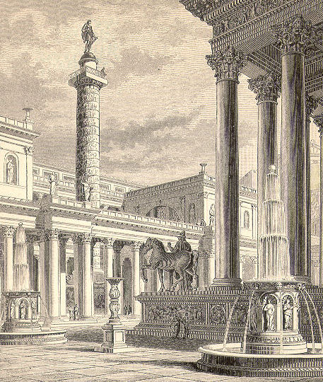
Forum of Trajan
By: Vanessa Francescangeli

Slide 2
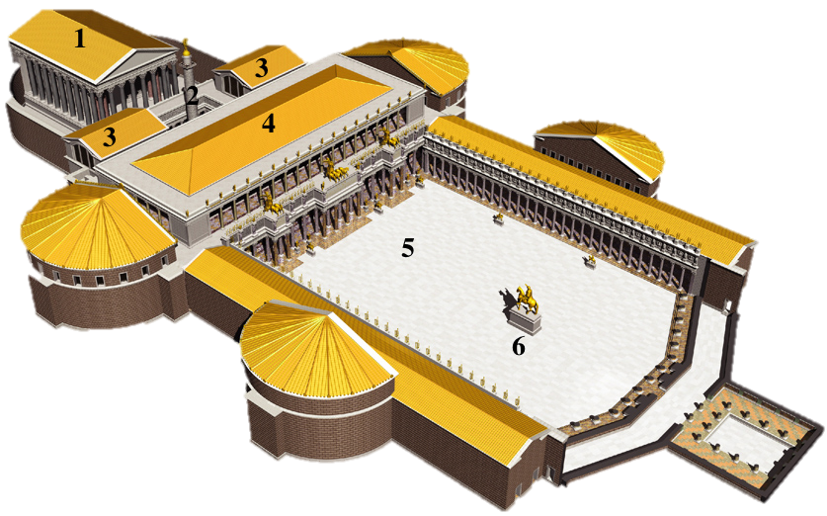
Forum of Trajan; 112 A.D.
By: Apollodorus of Damascus
Made out of marble, brick, bronze, and stone
Approximately 300 X 185 meters
Context: The patron of this forum was Marcus Ulpius Trajanus.
Content: The Trajan column is most famous for its spiral base reliefs, which artistically describes the epic wars between the Romans and Dacians.
Function: Two libraries surround the Trajan Column. Speculation is that they contained the soldier-emperor's account of the Roman-Dacian Wars.
Function: Forums are made as civic spaces such as social, commerical, and political centers.
Content: In the Basilica, there are many rows of columns separating the side aisles. This is a traditional means of structure for basilicas and can be traced back to Egyptian hypostyle Halls.
Form: Use of equestrian sculpture showing Trajan on horse. Significant because placed in the middle of the forum.

Slide 3
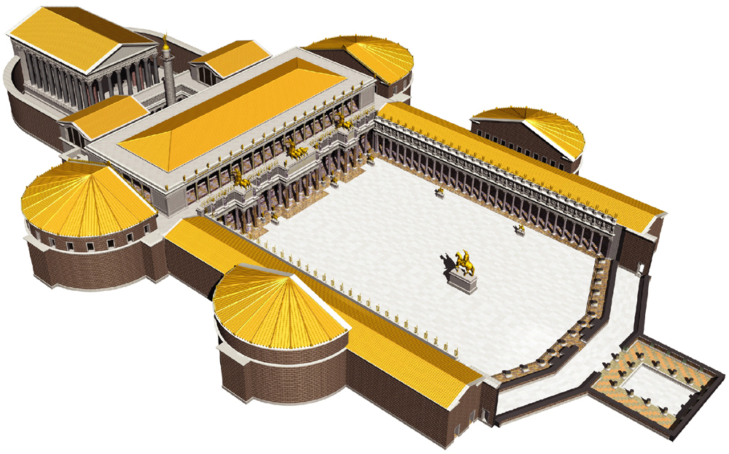
Function: The completion of the forum ended with the Temple of Trajan in order to honor the deceased emperor who was then declared a god.
Context: Unlike later Christian basilicas, this one had no known religious function; it was dedicated to the administration of justice, commerce and the presence of the emperor. It was also the largest in Rome.
10
9
8
7
Form: Grand scale depicts power and authority and importance to the culture at the time (principles of design).
Content: This forum was built on the order of the emperor Trajan to depict the conquest of Dacia. To build this monument, extensive excavations were required. Workers had to eliminated an entire hill in order to build the column and the libraries.

Slide 4
Works Cited:
https://www.google.com/search?q=forum+of+trajan&espv=2&biw=1242&bih=585&source=lnms&tbm=isch&sa=X&ved=0ahUKEwi97O78t4XPAhVKeyYKHbVOBVIQ_AUIBigB#imgrc=Adku6yW4bchmQM%3A
https://www.khanacademy.org/humanities/ancient-art-civilizations/roman/early-empire/v/trajans-forum
https://www.google.com/search?q=forum+of+trajan&espv=2&biw=1242&bih=585&source=lnms&tbm=isch&sa=X&ved=0ahUKEwi97O78t4XPAhVKeyYKHbVOBVIQ_AUIBigB#imgrc=2yM9vxb2qkRbLM%3A
https://en.wikipedia.org/wiki/Trajan's_Forum
https://www.khanacademy.org/humanities/ancient-art-civilizations/roman/early-empire/a/forum-and-market-of-trajan

