Slide 1
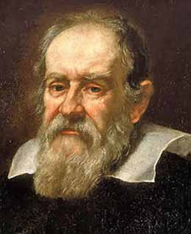
Galileo GaliLei
The Scientific revolution

Slide 2
In your textbook…
To help you understand the fluid nature of scientific thought in any age, read pp. 714-715 & 754-756.
Pay attention to questions #3 & 4 on p. 755 about the Galileo selections we will read shortly.

Slide 3
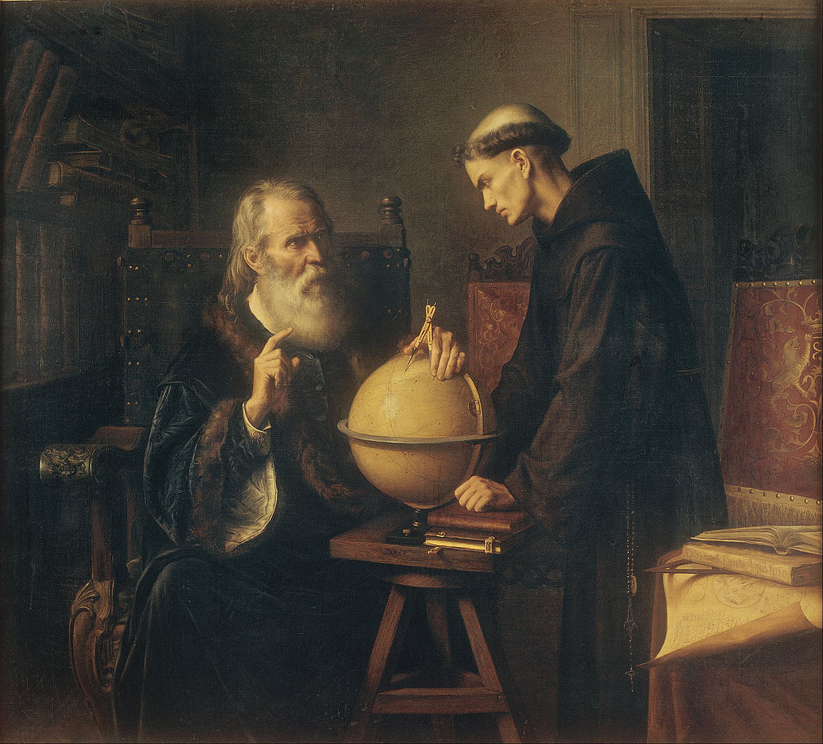
In your textbook…
Read The Starry Messenger pp. 758-761.
Discuss #3 & 4 p. 755.

