Slide 1
Islamic Art Period 3A

Slide 2
Dome of the Rock. Jerusalem. Islamic, Umayyad. 691–692 C.E., with multiple renovations. Stone masonry and wooden roof decorated with glazed ceramic tile, mosaics, and gilt aluminum and bronze dome.
First great monument of Islamic art, the Dome of the Rock is where the Muslims believe Muhammad ascended to the presence of God on the Night Journey.
The Dome of the Rock was conceived not as a place of worship, but rather as a sanctuary marking a particularly holy site.
The very name of this building describes its function, covering the rock from which Muhammad ascended into Heaven.

Slide 3
The structure is crowned by a golden dome, which serves as a cover for the holy rock in the center. Inscriptions from the Qur’an decorate in and around the outer arcades.
The octagonal plan and the rotunda dome of wood are of Byzantine design. Suleiman I in 1561 added the Persian tiles on the exterior and the marble slabs that decorate the interior.
The 60-foot-diameter, timber-framed double dome rises 35 meters over the holy rock.
The dome rests on a circular arcade of 12 marble columns, set in threes between four large rectangular piers. At the top of the drum, 16 colored glass windows light the central space.

Slide 4
The rock outcropping inside was sacred to Jews who claimed it was the rock where Abraham prepared to sacrifice his son.
In Islam, the rock is believed to be where Muhammad ascended to the heavens, received advice from God, and then returned home.
The Jewish Temple of Solomon might have been founded on the same rock.
It has been suggested that Umayyad Caliph Abd al-Malik who commissioned this structure wanted it to outshine the Christian monuments already constructed in Jerusalem or even to create a more spectacular site than the Kaaba in Mecca.
The mosaics in the Dome of the Rock contain no human figures or animals, only vegetal scrolls and motifs, jewels, vessels and winged crowns worn by Sasanian kings. Chalices refer to triumph of Islam over Byzantium.

Slide 5
Folio from a Qur’an. Arab, North Africa, or Near East. Abbasid. c. eighth to ninth century C.E. Ink, color, and gold on parchment.
The gold bar separates “surahs,” or chapters, in the Qur’an, and introduces the title of the surah, and states “In the name of God, the Compassionate, the Merciful.”

Slide 6
Features of this excerpt from the Qur’an include the use of parchment instead of polished paper, a square format, and deep, rounded letter terminals, as seen in this example.
Calligraphy is the most highly regarded and most fundamental element of Islamic art.
The development of Islamic calligraphy is strongly tied to the Qur'an; chapters and excerpts from the Qur'an are a common and almost universal text upon which Islamic calligraphy is based.
The Arabic text of the Qu’ran is sacred to Muslims, and its high status gave rise to an associated respect for books in general.

Slide 7
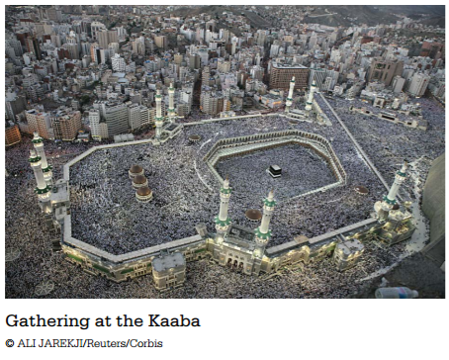
The Kaaba. Mecca, Saudi Arabia. Pre-Islamic monument; rededicated by Muhammad in 631-632 C.E.; multiple renovations. Granite masonry, covered with silk curtain and calligraphy in gold and silver-wrapped thread.
https://www.khanacademy.org/humanities/ap-art-history/west-and-central-asia/a/the-kaaba
VIDEO: https://www.newsweek.com/what-hajj-here-are-rituals-muslims-perform-during-pilgrimage-1077238

Slide 8
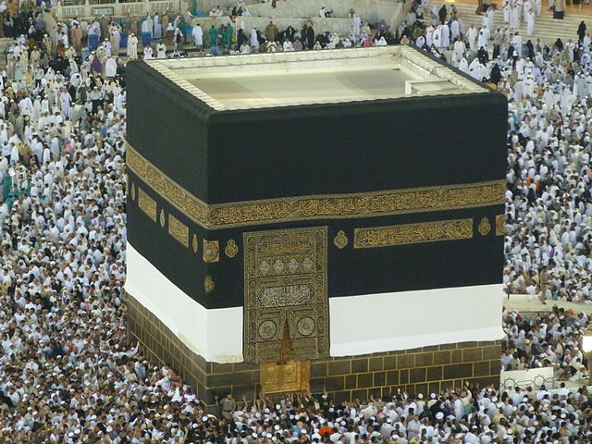
The Kaaba is a black stone building in Mecca that is shaped like a cube and is the most sacred Muslim pilgrimage shrine. Devout Muslims turn in its direction to pray five times each day.
The name Kaaba means, “cube,” but the structure isn’t a cube: it measures 12m long, 10m wide, and 15m high (33 feet x 50 feet x 45 feet).
The Kaaba is built from grey granite and each corner points to one of the four points of the compass.
The single entrance is on the northeast, side, 2.3m above the ground. The interior of the Kaaba is bare except for three supporting wooden pillars and gold hanging lamps.
Affixed to the eastern corner of the Kaaba, about 1.5m up, is the Black Stone of Mecca.
The exterior of the Kaaba is usually covered with a large black cloth called the kiswah (“robe”) that has Quranic verses embroidered with gold thread on it. Each year a new one is created.

Slide 9
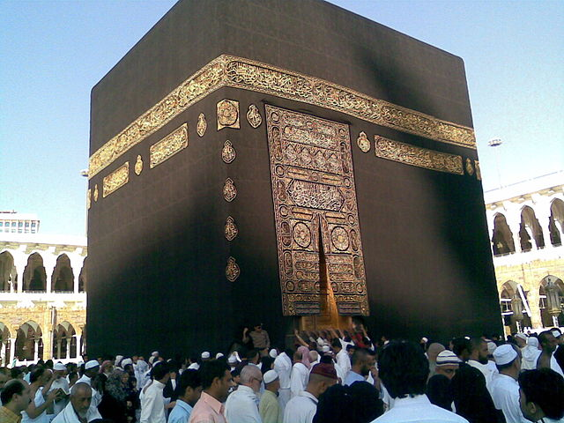
The Kaaba is a symbolic center of the Islamic world, it is the destination of hajj (the obligatory pilgrimage).
According to Muslim traditions, Adam built the original Kaaba as a copy of and directly below God’s throne in heaven.
This structure was destroyed during the great Flood, leaving behind nothing but the foundation. The current structure was rebuilt by Abraham (Ibrahim) and his son Ishmael (Ismail).
The Black Stone was a gift to Adam when he and Eve were expelled from the Garden of Eden and later became a symbol of God’s covenant with Abraham, Ismail, and thus the Muslim community.
Muslims call to it the “cornerstone of the House” or the “right hand of God on earth” and say it was originally white, but went black by absorbing sins. It thus serves as a symbol of human degradation and need for God’s forgiveness.
When the Muslims walk around the Kaaba, Muslim pilgrims often try to reach out and touch or kiss the Black Stone, which is now worn with age and is held together by a silver band.

Slide 10
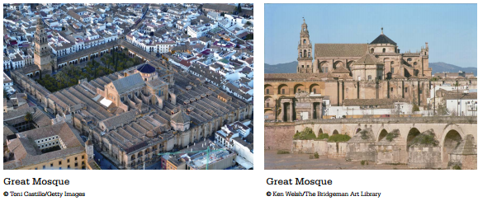
Great Mosque. Córdoba, Spain. Umayyad. Begun c. 785–786 C.E. Stone masonry.
Comprised of a large hypostyle prayer hall (hypostyle means, filled with columns), a courtyard with a fountain in the middle, an orange grove, a covered walkway circling the courtyard, and a minaret (a tower to call the faithful to prayer).
https://www.khanacademy.org/humanities/ap-art-history/early-europe-and-colonial-americas/ap-art-islamic-world-medieval/a/the-great-mosque-of-cordoba

Slide 11
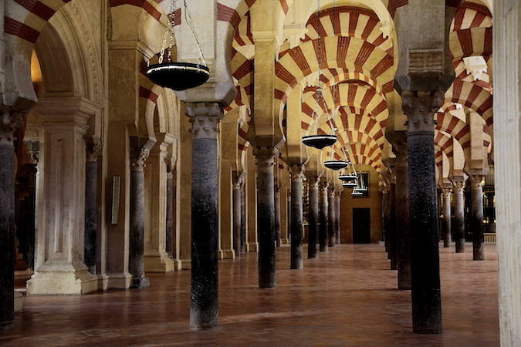
Historians believe that there had first been a temple to the Roman god, Janus, on this site. Columns and arches are reminiscent of Roman architecture.
The temple was converted into a church by invading Visigoths who seized Cordoba in 572.
Next, the church was converted into a mosque and then completely rebuilt by the descendants of the exiled Umayyads.
Currently, it is a cathedral.

Slide 12
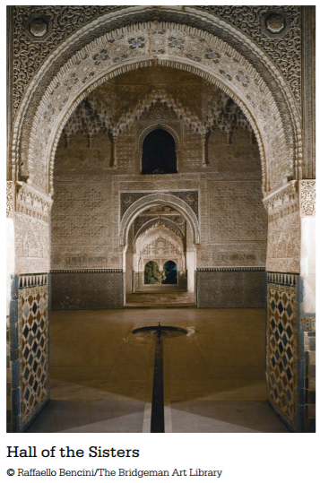
Alhambra. Granada, Spain. Nasrid Dynasty. 1354–1391 C.E. Whitewashed adobe stucco, wood, tile, paint, and gilding.
https://www.khanacademy.org/humanities/ap-art-history/early-europe-and-colonial-americas/ap-art-islamic-world-medieval/a/the-alhambra

Slide 13
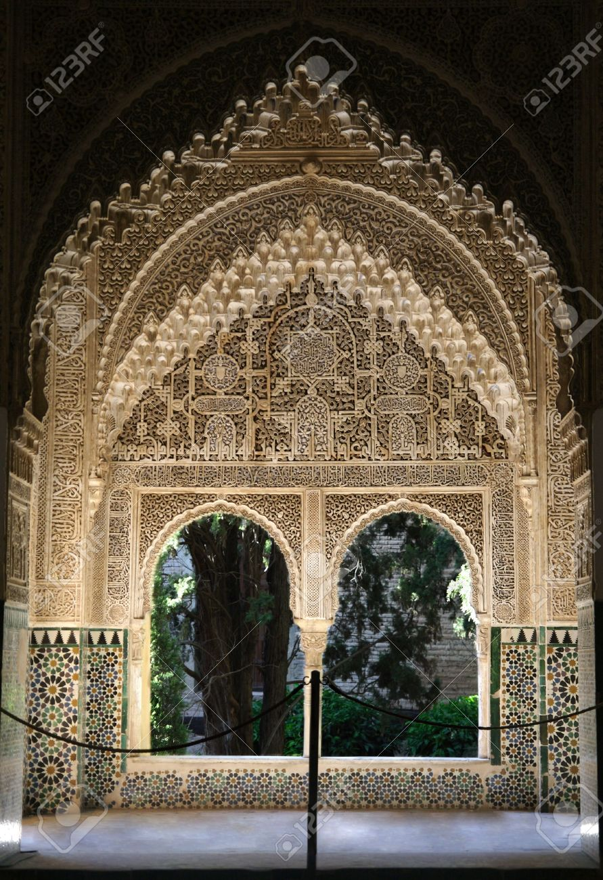
The Alhambra gets its name from its reddish walls (in Arabic, it means Red Castle). Created originally for military purposes, the Alhambra was an fortress, a place, and a small "medina" (city), all in one.
A pavilion has filigree (ornamental work of fine typically gold or silver wire formed into delicate tracery) walls and light domed roof, elaborately ornamented. The square is paved with colored tiles, and the colonnade with white marble; while the walls are covered 1.5 m up from the ground with blue and yellow tiles, with a border above and below enameled blue and gold.
The arches and pillars are adorned by varieties of foliage.
Above each arch there is a large square of arabesques (rhythmic linear patterns of scrolling and interlacing foliage, tendrils) and over the pillars is another square of filigree work.

Slide 14
The Courtyard of the Lions is an oblong courtyard, 35 m in length by 20 m in width, surrounded by a low gallery supported on 124 white marble columns.
The courtyard layout uses the proportions of the golden ratio. (See next slide.)
The courtyard demonstrates the complexity of Islamic geometric design – the varied columns are placed so they are symmetrical on numerous axes.
The stuccowork has a lacelike detail.
A fountain channels water through the mouths of 12 marble lions.

Slide 15
Golden Ratio
The golden ratio (symbol is the Greek letter "phi" shown at right) is a special number approximately equal to 1.618
It appears many times in geometry, art, architecture and other areas.

