Slide 1
Medieval Art
Byzantine, Romanesque, Gothic

Slide 2
Byzantine Art
Years: 476-1450 CE
Region: Eastern Roman Empire
Style: Christian religious expressions; Theology emphasized; One-dimensional figures; Solemn gazes; Long faces
Books: Illuminated manuscripts w/ special covers, embroidered pages, gold linings
Architecture: Domes that show order of universe: God in center, lesser beings below
Paintings: Frescoes, mosaics

Slide 3
Hagia Sophia. Constantinople (Istanbul). Anthemius of Tralles and Isidorus of Miletus. 532–537 C.E. Brick and ceramic elements with stone and mosaic veneer.
ARTICLE
https://www.khanacademy.org/humanities/ap-art-history/early-europe-and-colonial-americas/medieval-europe-islamic-world/a/hagia-sophia-istanbul
VIDEO https://www.khanacademy.org/humanities/ap-art-history/early-europe-and-colonial-americas/medieval-europe-islamic-world/v/hagia-sophia-mosque

Slide 4
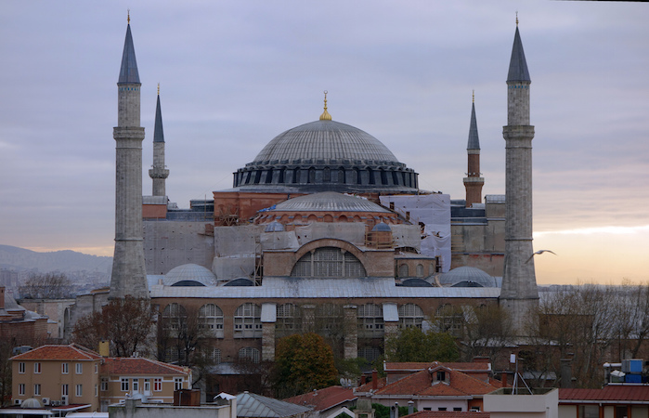
The great church of the Byzantine capital Constantinople (Istanbul) took its current structural form under the direction of the Emperor Justinian I.
The church was dedicated in 537, amid great ceremony and the pride of the emperor (who was sometimes said to have seen the completed building in a dream).
The daring engineering feats of the building are well known. Numerous medieval travelers praise the size and embellishment of the church.
Hagia Sophia is the symbol of Byzantium in the same way that the Parthenon embodies Classical Greece or the Eiffel Tower typifies Paris.

Slide 5
Santa Sabina, Rome c. 422-432 CE

Slide 6
A dominant central axis leads from the entrance to the apse, the site of the altar.
This central space, known as the nave, is flanked on either side by side aisles.
The architecture is relatively simple with a wooden, truss roof.
The wall of the nave is broken by clerestory windows that provide direct lighting in the nave.

Slide 7
City of Ravenna served as capitol of Western Roman Empire.
Church of San Vitale was commissioned by Ecclesius.
Octagonal plan w/dome

Slide 8
San Vitale is best known for its elaborate mosaics

Slide 9
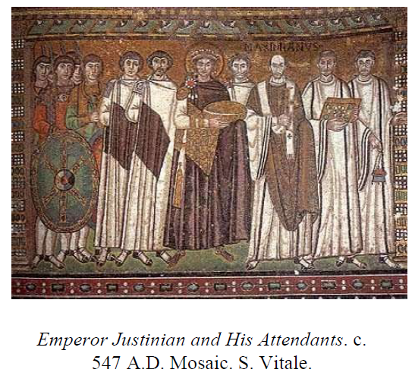
Justinian ruled as pope and emperor of the Byzantine Empire (ceasaropapism).
Portraits of Justinian and Theodora serves as propaganda for Justinian’s role as “regent of Christ on Earth.”
Against a gold background, Justinian wears an imperial purple cloak; a halo encircles his crown; he holds communion bread.
Justinian is the center and most imposing figure.

Slide 10
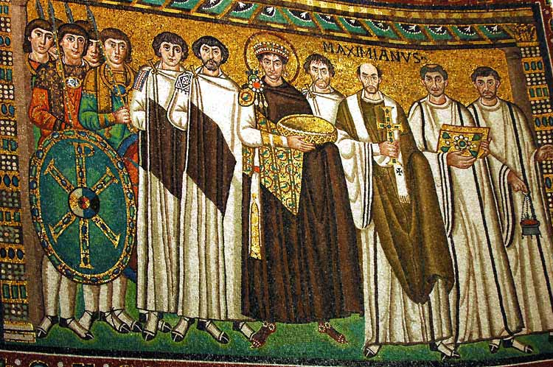
The soldiers to Justinian’s right exhibit the crowd phenomenon—more heads than feet and overlapping feet.
Note the large, wide eyes and solemn stares of the one- dimensional figures.

Slide 11
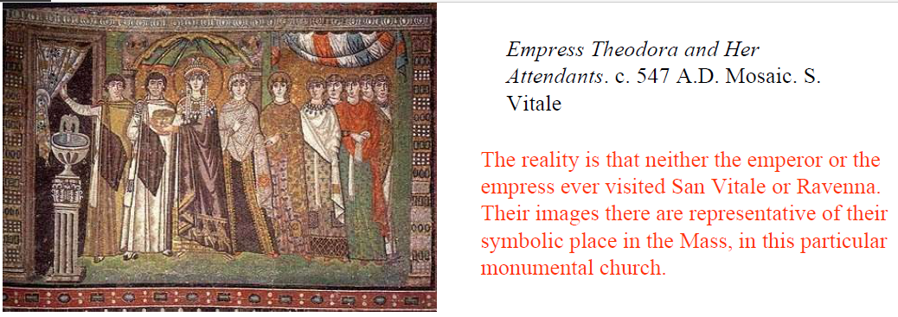
Directly across the church from Justinian is his empress, Theodora. She offers a large communion chalice.
Though she is not center, she is the focal point surrounded by a shell niche and curtained architecture.

Slide 12
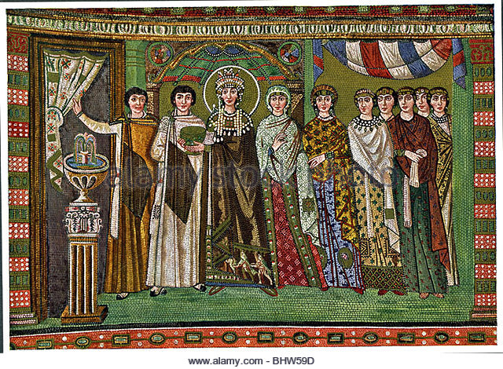
Theodora is haloed.
Her crown drips with iridescent pearls which were thought to ward off sickness.
Note the one-dimensional fountain and crowd phenomenon with her ladies.

Slide 13
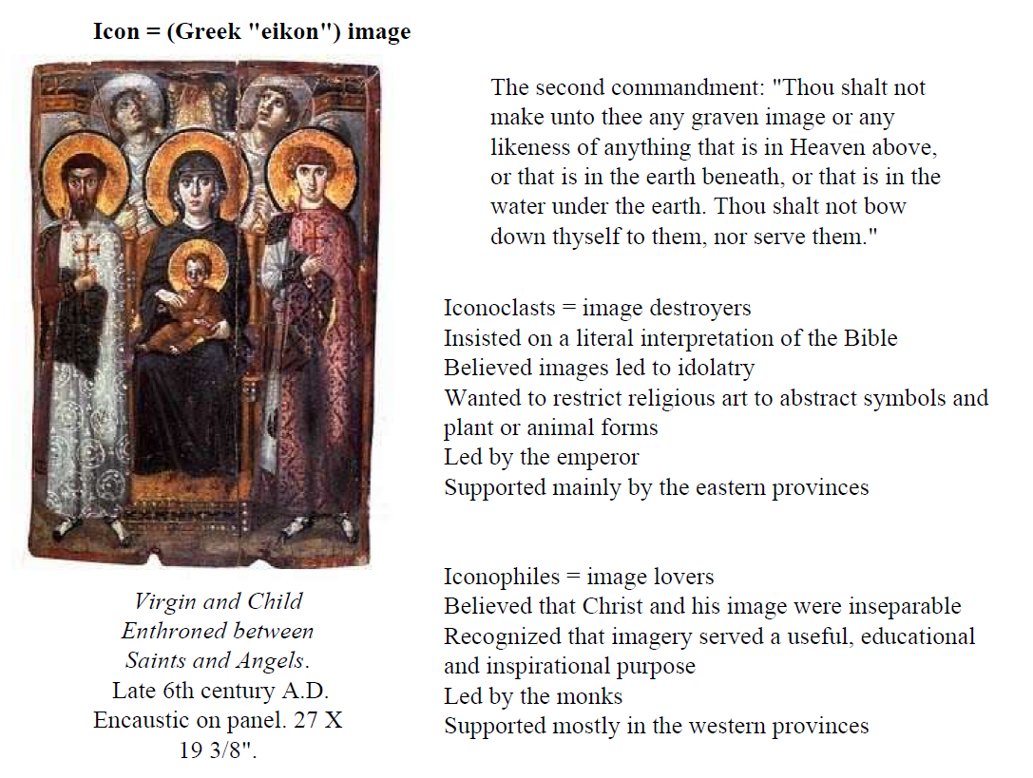

Slide 14
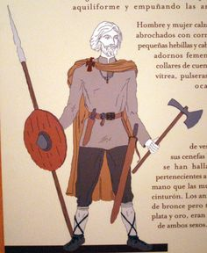
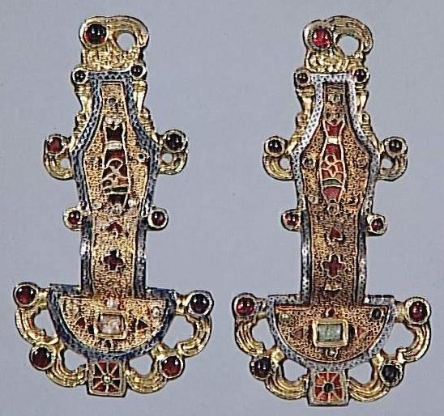
Merovingian Looped Fibulae

Slide 15
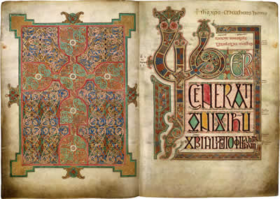
Lindisfarne Gospels
700 CE
Illuminated Manuscript

Slide 16
