Slide 1
Gothic Art
Years: 1100-1500 CE
Region: Europe
Style: More realistic and life-like figures, naturalistic; Secular themes; Chivalric themes
Books: Printed paintings take place of illuminated manuscripts
Architecture: Ribbed vaults; flying buttresses; pinnacles
Paintings: Life-like and colorful

Slide 4
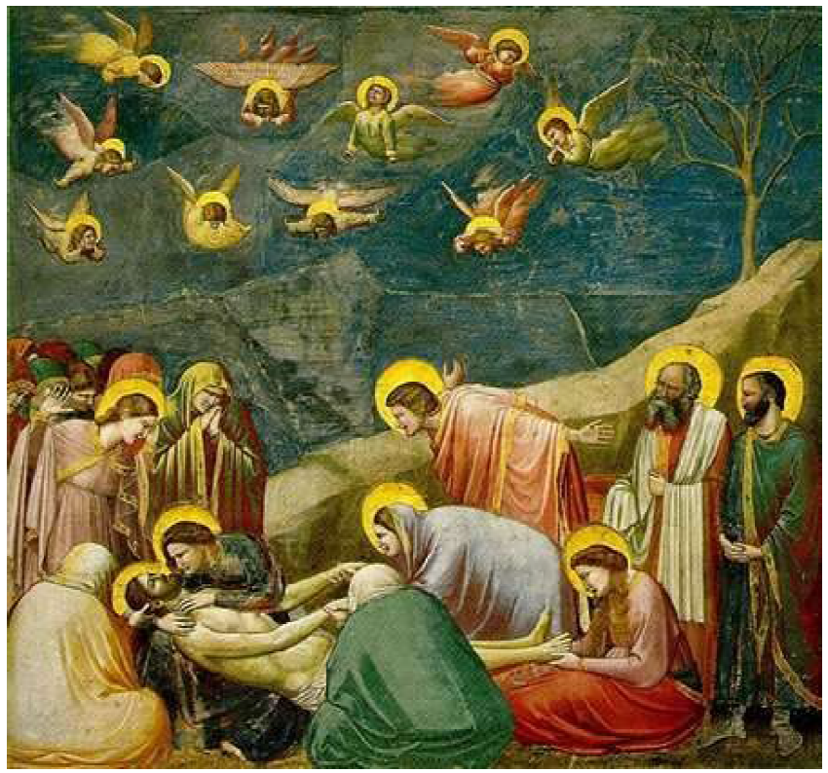
Giotto is known as the father of Western painting.
Rational sense of space (not yet vertical sense, but figures overlap)
Chiaroscuro=play of light and shadow or shading to create depth and realism
Foreshortened arms of angels project forward (as objects move toward the front, they look shorter)

Slide 9
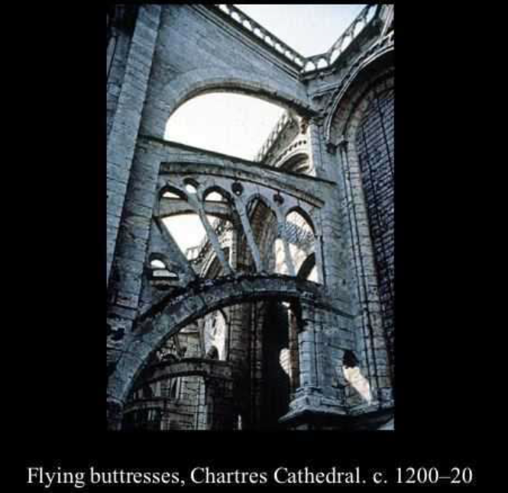
Flying buttress, masonry structure typically consisting of an inclined bar carried on a half arch that extends (“flies”) from the upper part of a wall to a pier some distance away and carries the thrust of a roof or vault. A pinnacle (vertical ornament of pyramidal or conical shape) often crowns the pier, adding weight and enhancing stability. The flying buttress evolved in the Gothic era from earlier simpler, hidden supports. The design increased the supporting power of the buttress and allowed for the creation of the high-ceilinged churches typical of Gothic architecture.

Slide 15
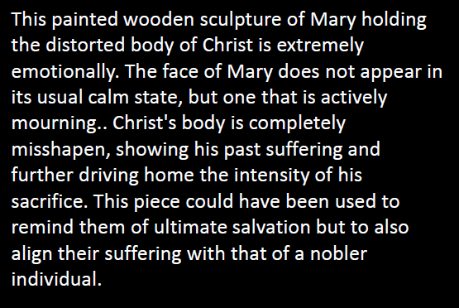

Slide 16
Artist: Jan Van Eyck
Triptych= three panels

Slide 17
