Slide 1
MLA Format
Use this for EVERY essay.

Slide 2
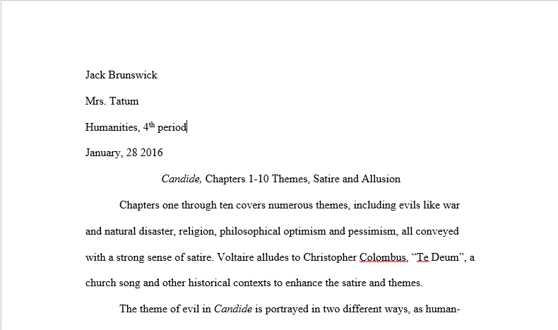
Heading
Upper Left Corner Of The First Page
Your Name
Mrs. Tatum
Class , Period
Date
(Space one line before typing your title.)

Slide 3
Title
Center and type the title of the paper.
Use standard capitalization rules.
Space one line between the title and the body of the paper.
Do not underline, bold, italicize or otherwise alter the title (unless there is a title in your title).

Slide 4
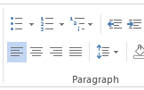
Double Space
Double-space the body of the paper.
In Microsoft Word: Go to Paragraph in the tool bar (or right click and choose Paragraph). Under Indents and Spacing go to Line Spacing. Choose “Double” or “2.0.”

Slide 5
Font
For a typed paper, use 12-point Times New Roman font only.

Slide 6
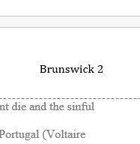
Page Numbers
Number all pages in the upper right-hand corner.
Type your name immediately before the page number with no comma.
Highlight your name and the page number; choose TNR 12. Word DOES NOT default to the font and size of the rest of the paper.

Slide 7
Somebody Says Lead-in
Begin with a reference to the speaker.
Add a “says” word such as “admits,” “supposes,” “argues,” “reflects,” etc.
Add a comma after the “says” word.

Slide 8
Blended Lead-in
Begin with your own sentence.
Blend the quote into your sentence seamlessly.
Add punctuation that would naturally occur in the sentence.

Slide 9
Sentence Lead-in
Begin with a COMPLETE sentence that refers to the topic of the quote.
Add a colon at the end of the sentence before quote.
Add a COMPLETE sentence quote.

Slide 10
Parenthetical (or In-text) Citations
Citations go inside parentheses at the end of the quotation.
Place the AFTER the final quotation mark and BEFORE the final punctuation of the sentence.
Use the author’s last name and page or line number.
If the author’s name is mentioned in the sentence lead-in, do not place it in the citation since it is redundant.

