Slide 1
Realism
A literary movement of the early 1820s to the late 1860s

Slide 2
Definition of Realism
Realist writers reacted against Romanticism and responded to the industrial and scientific advancements that began to transform society.
Realism presents “a faithful representation of reality.“
Portrays mostly middle- and working-class city dwellers from criminals to unhappy upper-class women
Strives to project characters in an honest, objective, factual way

Slide 3
A Reaction Against Romanticism
Romanticism
realism
Imaginative situations
kings and queens, warriors and knights, demonic cats, ghosts, sea creatures, monsters
Focus on plot
Ordinary people and events
farmers, merchants, lawyers, laborers, bakers
Focus on character

Slide 4
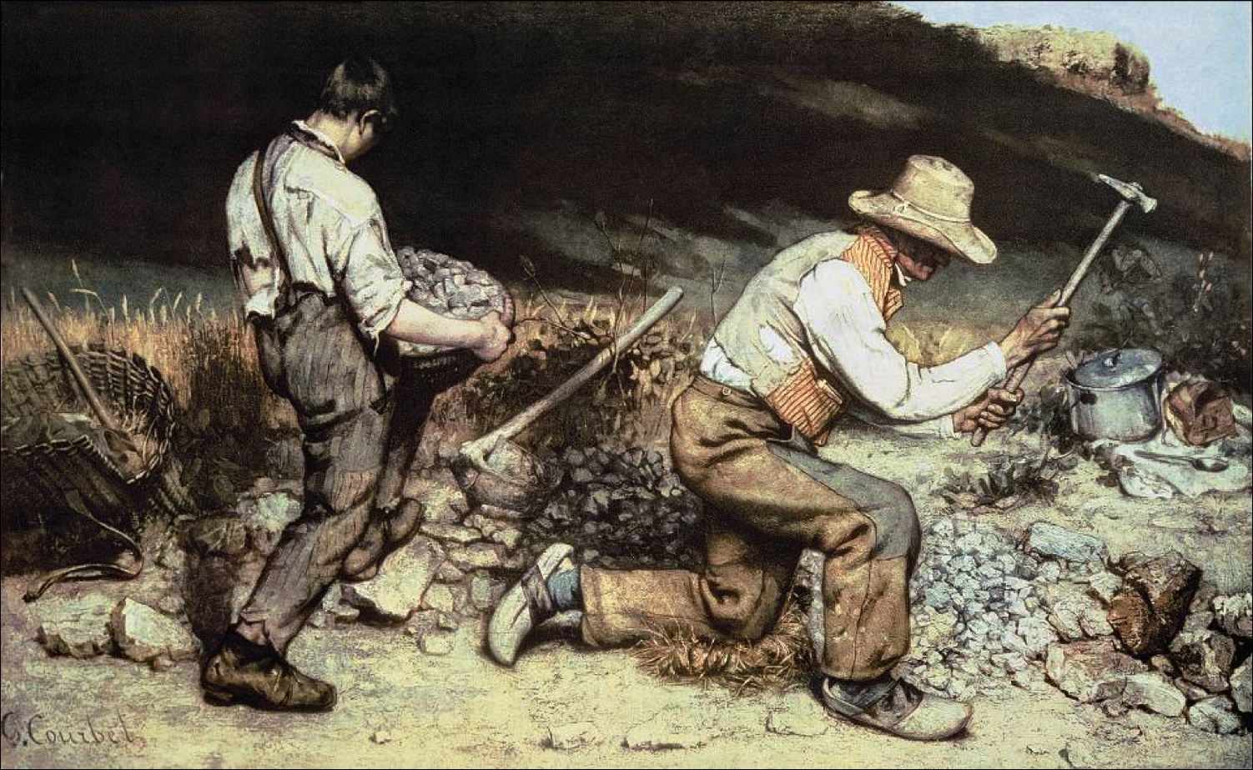
Writers of Realism
Honore de Balzac (France)
Gustave Flaubert (France)
Charles Dickens (England)
Henrik Ibsen (Norway)
Leo Tolstoy (Russia)
Feodor Dostoyevsky (Russia)

Slide 5
Excerpt from Madame Bovary by Gustave Flaubert
She gave up playing the piano. Why practice? Who would ever hear her? Since she would never play for an audience, in a short-sleeved velvet dress, on an Erard piano, skimming over the ivory keys with the lightest of fingers, never feel a murmur of ecstasy rising about her, what was the point of practicing any more? She left her sketch books and tapestry in the cupboard. What was the use? What was the use? Sewing made her nervous.
“I’ve read everything,” she said to herself.
So she sat there idly, holding the tongs in the fire until they turned red, or watching the rain fall.
How sad she felt on Sundays, when the church bell sounded for vespers! She stood in a kind of expectant daze, listening as each broken note rang out again, and again. A cat was stalking about the rooftops, arching its back in the last pale rays of sunshine. The wind blew trails of dust along the highroad. In the distance, a dog howled now and then, and the bell kept up its tolling, each monotonous note dying out over the countryside.

Slide 6
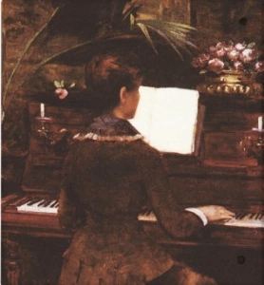
Meanwhile, people had begun to walk home from church. Women in polished wooden shoes, farmers in new smocks, little children gamboling bareheaded before them, everyone was going home. Five or six of the men, always the same, would linger in front of the inn, playing their game of tip-penny until dark.
The winter was a cold one. Every morning the window panes were thick with frost, and the one light which shone through them, as through ground glass, sometimes grew no brighter all day. The lamps had to be lit by four in the afternoon.
On sunny days Emma went out in the garden. Dew had left silvery lace on the cabbages, gleaming filaments stretching from one to the other. No birds sang; everything seemed asleep, the espaliered trees under their covering of straw, the grapevines like a great sick snake beneath the coping of the wall where, if one looked closely, one could see large wood lice dragging along on their many legs. Among the spruce trees near the hedge, the curate, in a tricorn, reading his breviary, had lost his right foot and the plaster, peeling because of the frost, had left white blotches on his face.

Slide 7
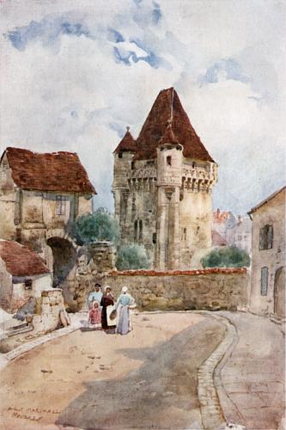
She then went back upstairs, closed her door, stirred the coals and, settling languidly by the warm fire, felt boredom sinking down upon her more oppressively than ever. She would have liked to chat with the maid, but a sense of propriety held her back.
Every day, at the same time, the schoolmaster in his black silk cap would throw open his shutters, and the village policeman would pass, his sword buckled over his smock. Morning and evening, the post horses would be led across the street, three by three, to drink at the pond. Now and then a bell would tinkle on a cafe door, and if it were windy, one could hear the little copper basins which the hairdresser used as his shop sign, clanking on their two iron rods. The hairdresser’s window display consisted of an old print of dated fashions pasted on one window pane, and the wax bust of a woman with yellow hair. He, too, was discontented; he mourned his wasted talents, his hopeless future, and dreamed of owning a shop in some large city, Rouen perhaps, on the harbour, or near the theatre district. Meanwhile, he paced gloomily up and down the main street of Tostes, from the town hall to the church, waiting for customers. Every time Madame Bovary looked out, she saw him there, like a sentry on duty, wearing a rough woolen jacket, his cap perched to one side.

Slide 8
Sometimes, in the afternoon a man’s head would appear outside the parlour window, a tan face with black side-whiskers, white teeth showing through a gentle broad smile. Right away a waltz would be heard, and on top of the barrel organ, miniature dancers would start to whirl about within a doll-size parlour: ladies in pink turbans, Tyrolleans in short jackets, monkeys in black tail coats, gentlemen in knee breeches. Round and round they went, between chairs, sofas, tiny console tables, reflected many times in fragments of mirror held together at the edges by gold paper. The man turned the crank, looking to the right, to the left, and up at the windows. Once in a while as he shot a long stream of brown saliva against the curbstone, he would lift the organ onto his knee to relieve his shoulders from the weight of the strap. Now lingering and sad, now joyous and swift, the music rumbled forth from the box, through a pink taffeta curtain behind a curving brass grill. Worldly echoes reached Emma’s ears, melodies heard in theatres, some in drawing rooms, or played for dancing beneath crystal chandeliers. Never-ending sarabands kept ringing in her head while her thoughts, like dancing girls on a flowered carpet, leapt high at each note, from dream to dream, from sorrow to sorrow. After the man had caught a few coins in his cap, he pulled an old cover of blue wool over the organ, slung it on his back, and walked away with heavy footsteps. She watched him go.

