Slide 1
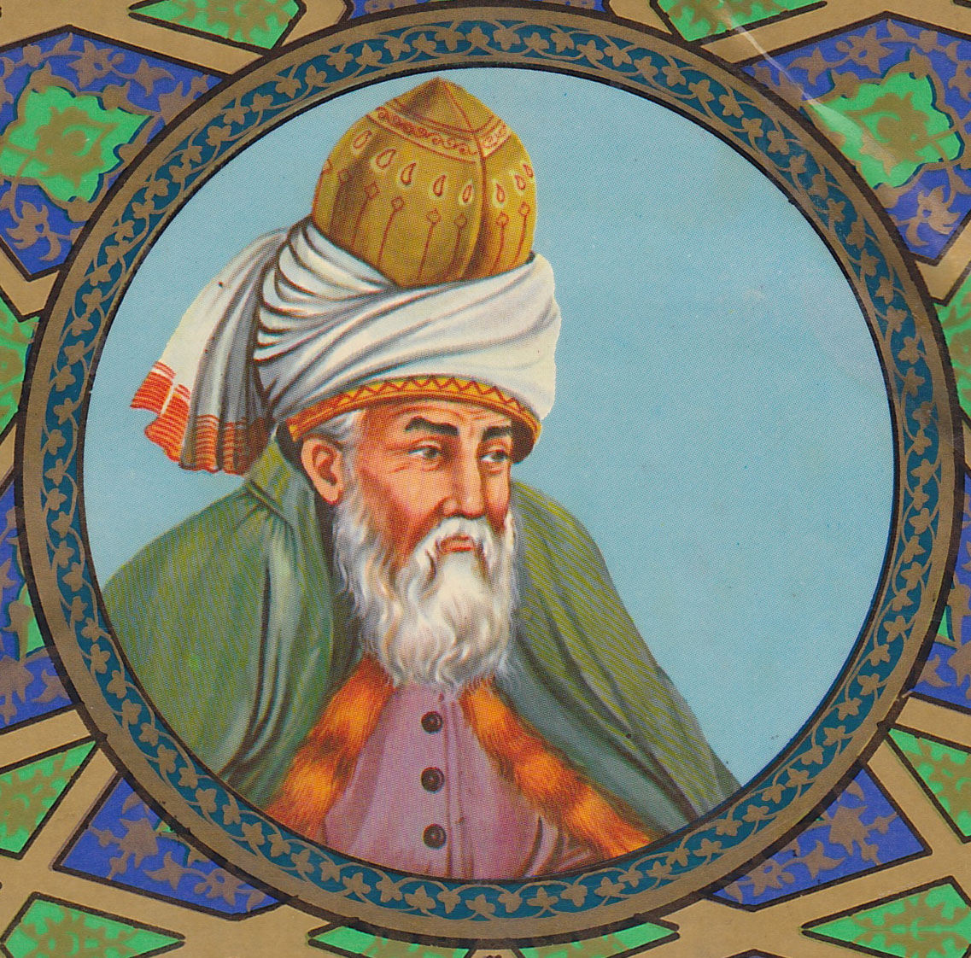
Rumi
Sufi poet and mystic
1207-1273

Slide 2
Background
Read the introduction to Rumi’s Mystical poetry on pp. 2-3 & 114-116 in your literature textbook and the handout.

Slide 3
Sufism
Sufism is an Islamic movement in the 10th century that stressed the immediate, personal union of the human soul with God
Sufism “belongs to the sciences of the religious law that originated in Islam”
Divine worship, devotion to God, aversion from the world, abstinence from wealth, retirement into solitude for worship – all common among early Muslims
Asceticism—negligence of the body and self
Intuitive perception of psychological states and stations
Self-scrutiny and quest for knowledge and unity with God
Special language for inner experience, parallel to other fields of religious knowledge

Slide 4
Rumi
Father was an Islamic teacher
Lived in what is modern Turkey
Became a Sufi master
Established “whirling dervishes” – a group who taught hypnotic dancing was a means to spiritual enlightenment
Considered the greatest mystical poet of Islam.
Attracted spiritual seekers from almost every religion in the world
Even in his day, Rumi was sought out by merchants and kings, devout worshippers and rebellious seekers, famous scholars and common peasants, men and women.
At his funeral, Muslims, Christians, Jews from Arabs, Persians, Turks and Romans honored him.

Slide 5
Literary Analysis Skills
Didactic literature: teaches beliefs of the culture through aphorisms or short, pointed statements of human truth
Analogy – comparison of how two things are similar
Metaphor
Direct: establishes direct connection
This being human is a guest house.
Implied: suggest comparison
…getting always more/ marks on your preserving tablets

Slide 6
Read Elephant in the Dark pp. 118-119.
Literal versus symbolic interpretations
Examination of part versus whole
Human distortions
Limitation of Human perceptions
Human cooperation

Slide 7
Read Two Kinds of Intelligence pp. 120-121.
Acquired intelligence versus innate intelligence
Inside out versus outside in
Memorization versus examination
Artificial intelligence

Slide 8
Read The Guest House pp. 122-123.
Human influences
Reception versus acceptance
Expected versus unexpected
Rejection versus acceptance – freedom?

Slide 9
Read Which is Worth More? P. 124.
Popularity versus solitude
Solitude versus isolation
Freedom
Power
Pride

Slide 10
My favorite Rumi quotes
“Out beyond ideas of wrongdoing and rightdoing there is a field. I'll meet you there.”
“Conventional opinion is the ruin of our souls.”
“Let the beauty of what you love be what you do.”

