Slide 1
Temple of Amun-Ra, and Hypostyle hall
Found in Karnak (near Luxor, Egypt)
Made during the 18-19th dynasties
Dated back to 1550 B.C.E (Temple), 1250 B.C.E (Hall)
Made with cut sandstone and mud brick
By: D’Andree Strozier

Slide 2
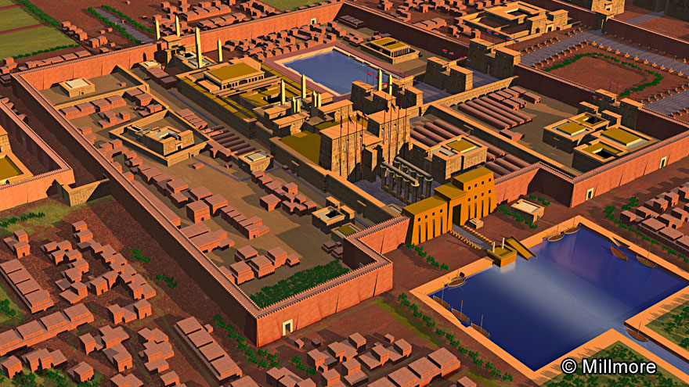
Context:
The temple structure was made to simplify the procession of the god during the annual festivals.
Content:
The main precinct was going to eventually withhold 20 temples and chapels.
Function:
The temple of Karnak was used to worship many gods of the culture. Especially Amun-Re
Form:
The main temple of Amun-Re had two axes-one that went north/south and the other that extended east/west.
Form:
The temple was built with cut sand stone and mud bricks .
Context:
It thirty pharaohs contributing to this structure to get it to where it is now.

Slide 3
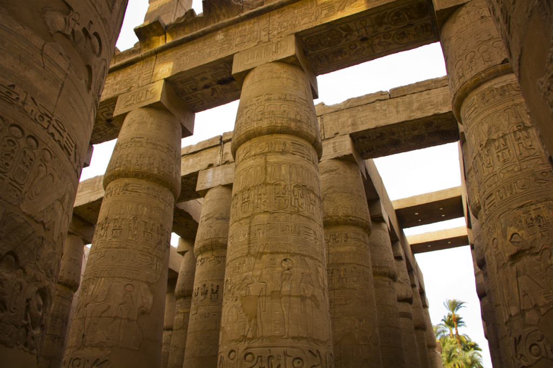
Content:
Pharaohs are also often shown presenting offerings or performing rituals for the gods
Content:
When there was walls, they were like most other walls and had representations of Amun, the principle deity of the temple.
Form:
There were 134 papyrus columns in 16 rows. The two middle rows were higher than the others.
Context:
Priests and Pharaohs were the only people to enter these halls, they used this room for performing religious rituals
Form:
They made clerestory windows so they made dim lighting for the symbolism of the room.
Function:
These columns were used to support the roof.

Slide 4
Bibliography for Annotations
https://www.khanacademy.org/humanities/ancient-art-civilizations/egypt-art/new-kingdom/a/karnak
Temple of Amun-Ra, and Hypostyle hall, Karnak sheet
Google for the Images

